Slide 1
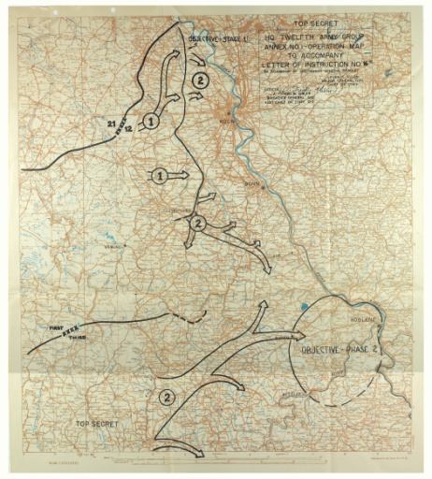
WE’LL DOCUMENT OUR BOYS (AND GIRLS)!
Researching the Southern Home Front During World War II at the National Archives at Atlanta

Slide 2
Agenda
Symposium Initiative
Finding Aids
Research Topics
Science and Technology
Civil Rights
Transportation
Homeland Defense
Labor and Industry
Questions
Workers at the Augusta (GA) Arsenal, ca. 1944; Assorted Arsenal Files, 1942-1955; Records of the Office of the Chief of Ordnance, Record Group 156

Slide 3
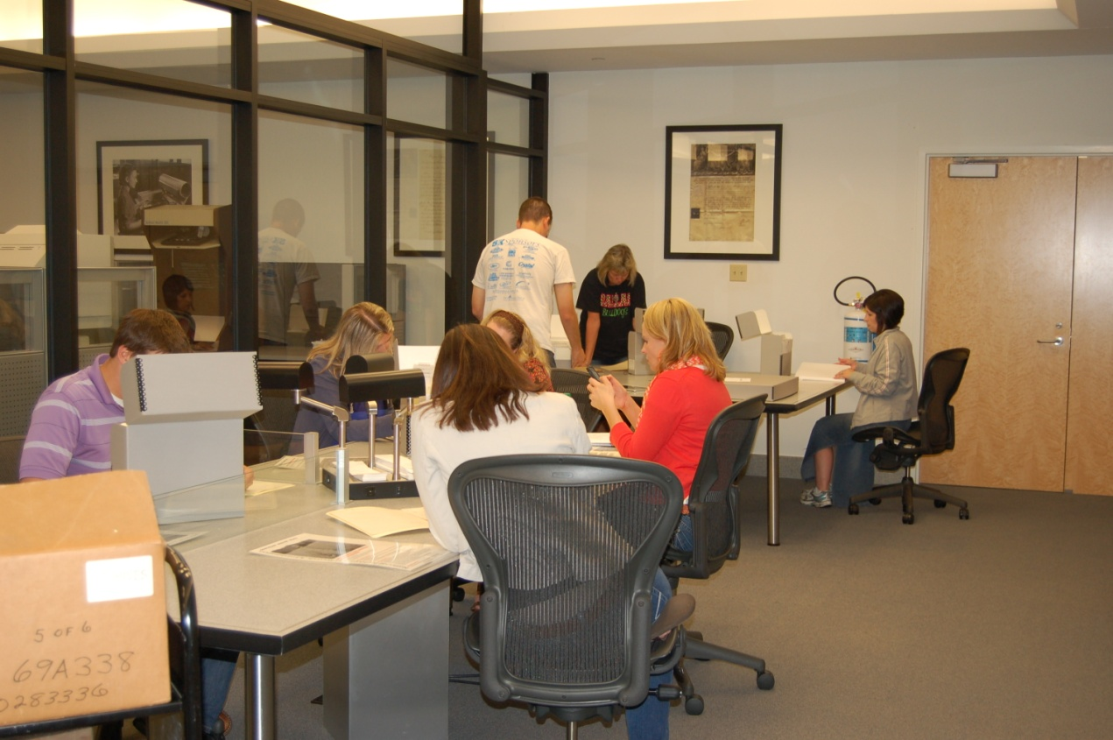
Year-long Initiative
Intern and Volunteer projects
RG 21, RG 22, RG 142, RG 156, RG 181, RG 211, RG 336, RG 442
Online Exhibit
Online Finding Aids
Onsite Workshops
Local Teachers
Home School students
Undergraduate students
950 photographs
9500 database entries
100 linear feet
described at item level
Paulding County (GA) Educators, June 2013

Slide 4
Finding Aids Webpage
http://friendsnas.org/wwii/

Slide 5
Slide title
Record Group (RG)
Document Information
Series Title, Dates
Is there an index, folder list, finding aid?
Document, photograph, map, etc.

Slide 6
Science and Technology

Slide 7
Science & Technology Records
RG 142 – Tennessee Valley Authority
Power generation, chemical production
RG 326 – Atomic Energy Commission
(Manhattan Engineer District)
Manhattan Project and Oak Ridge operations
RG 442 – Centers for Disease Control (Public Health Service)
Malaria control, VD education

Slide 8
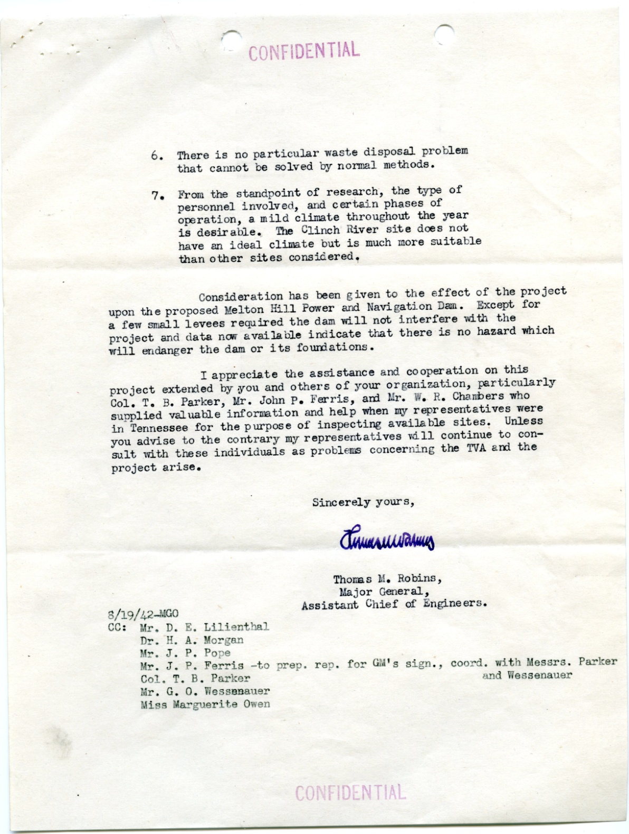
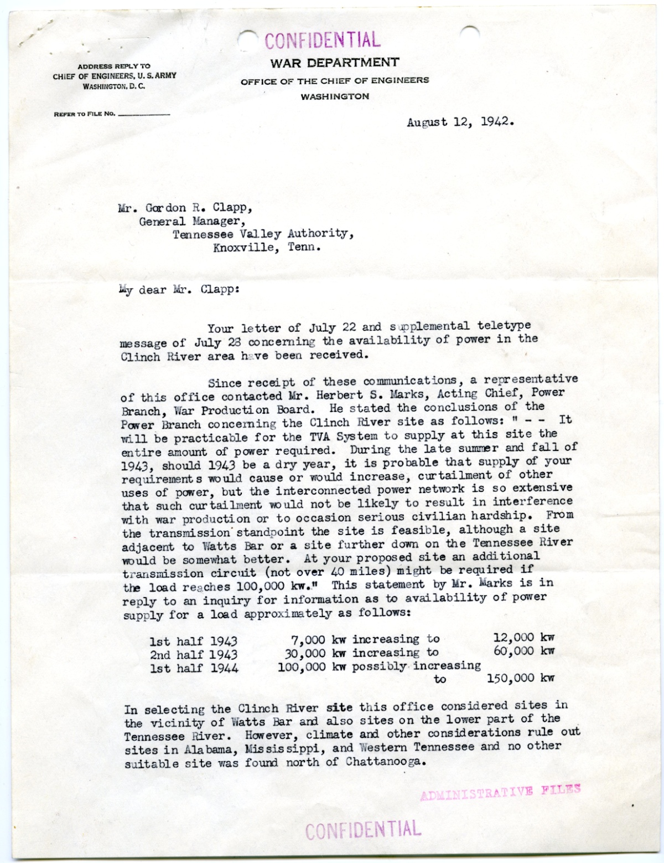
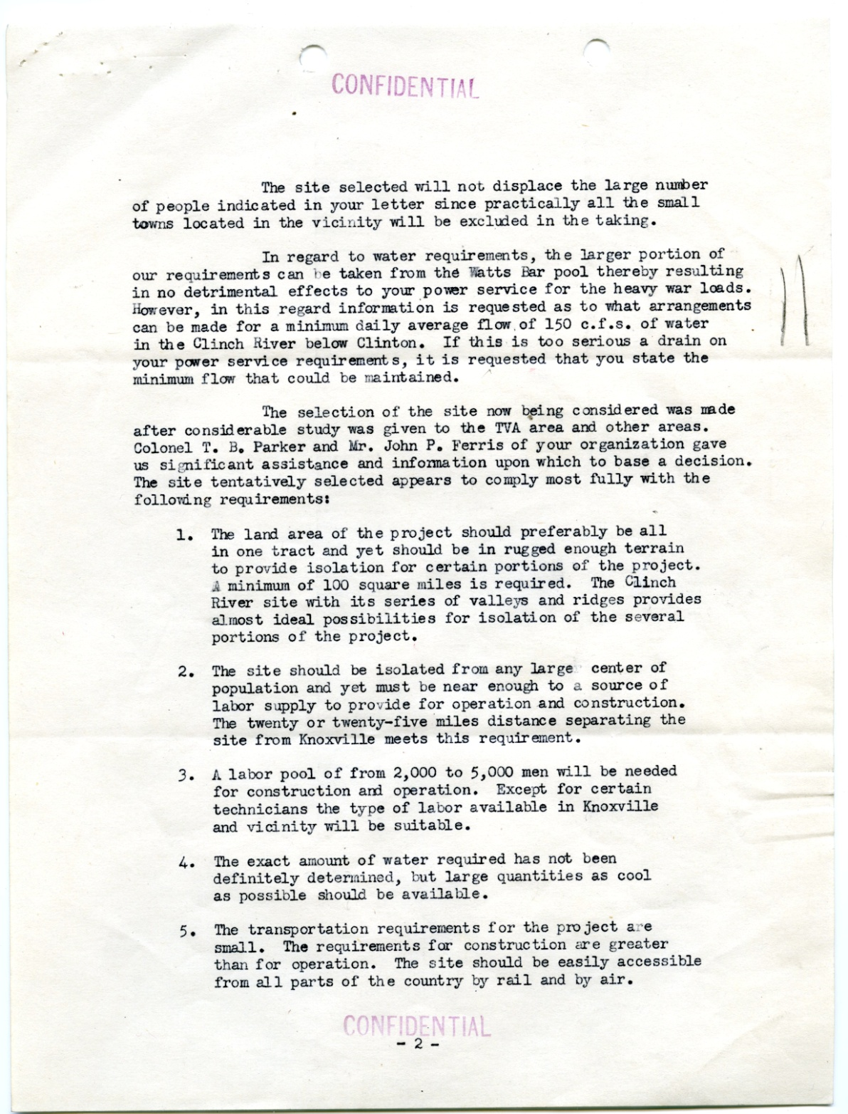
Powering the War Effort
RG 142
Letter about Clinch River Site Selection, 1942
Office of the General Manager Administrative Files, 1933-1957

Slide 9
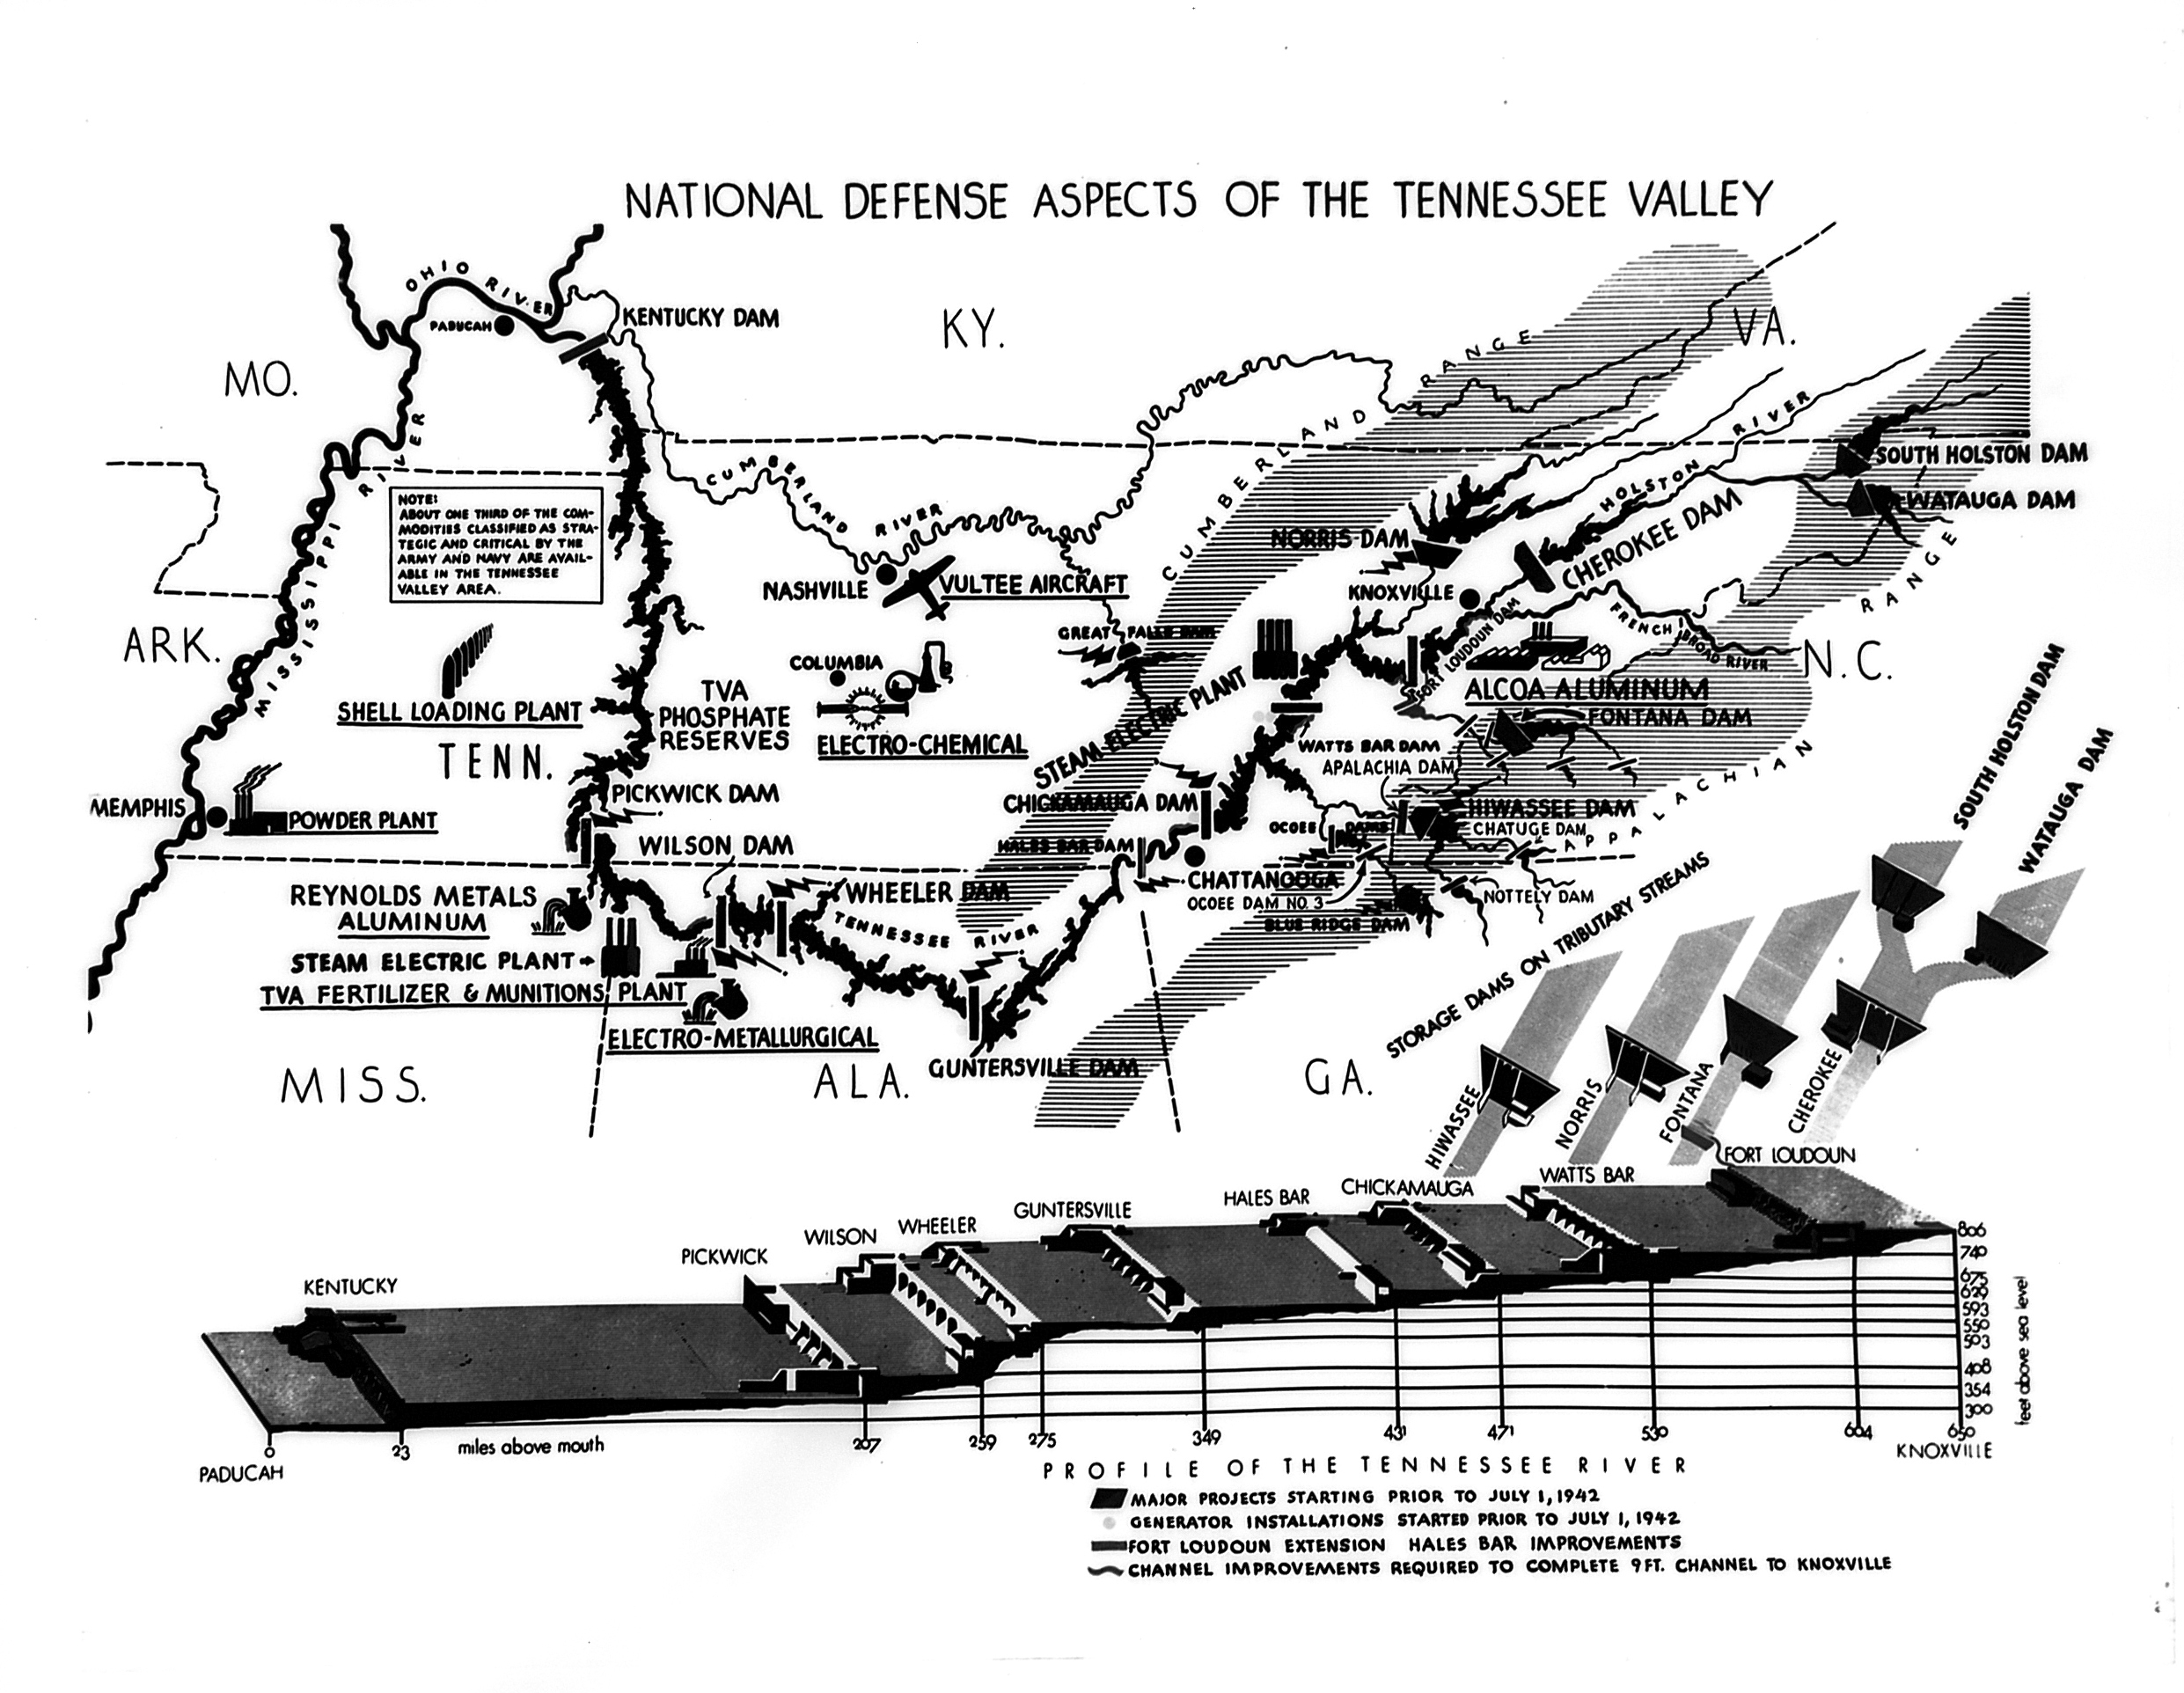
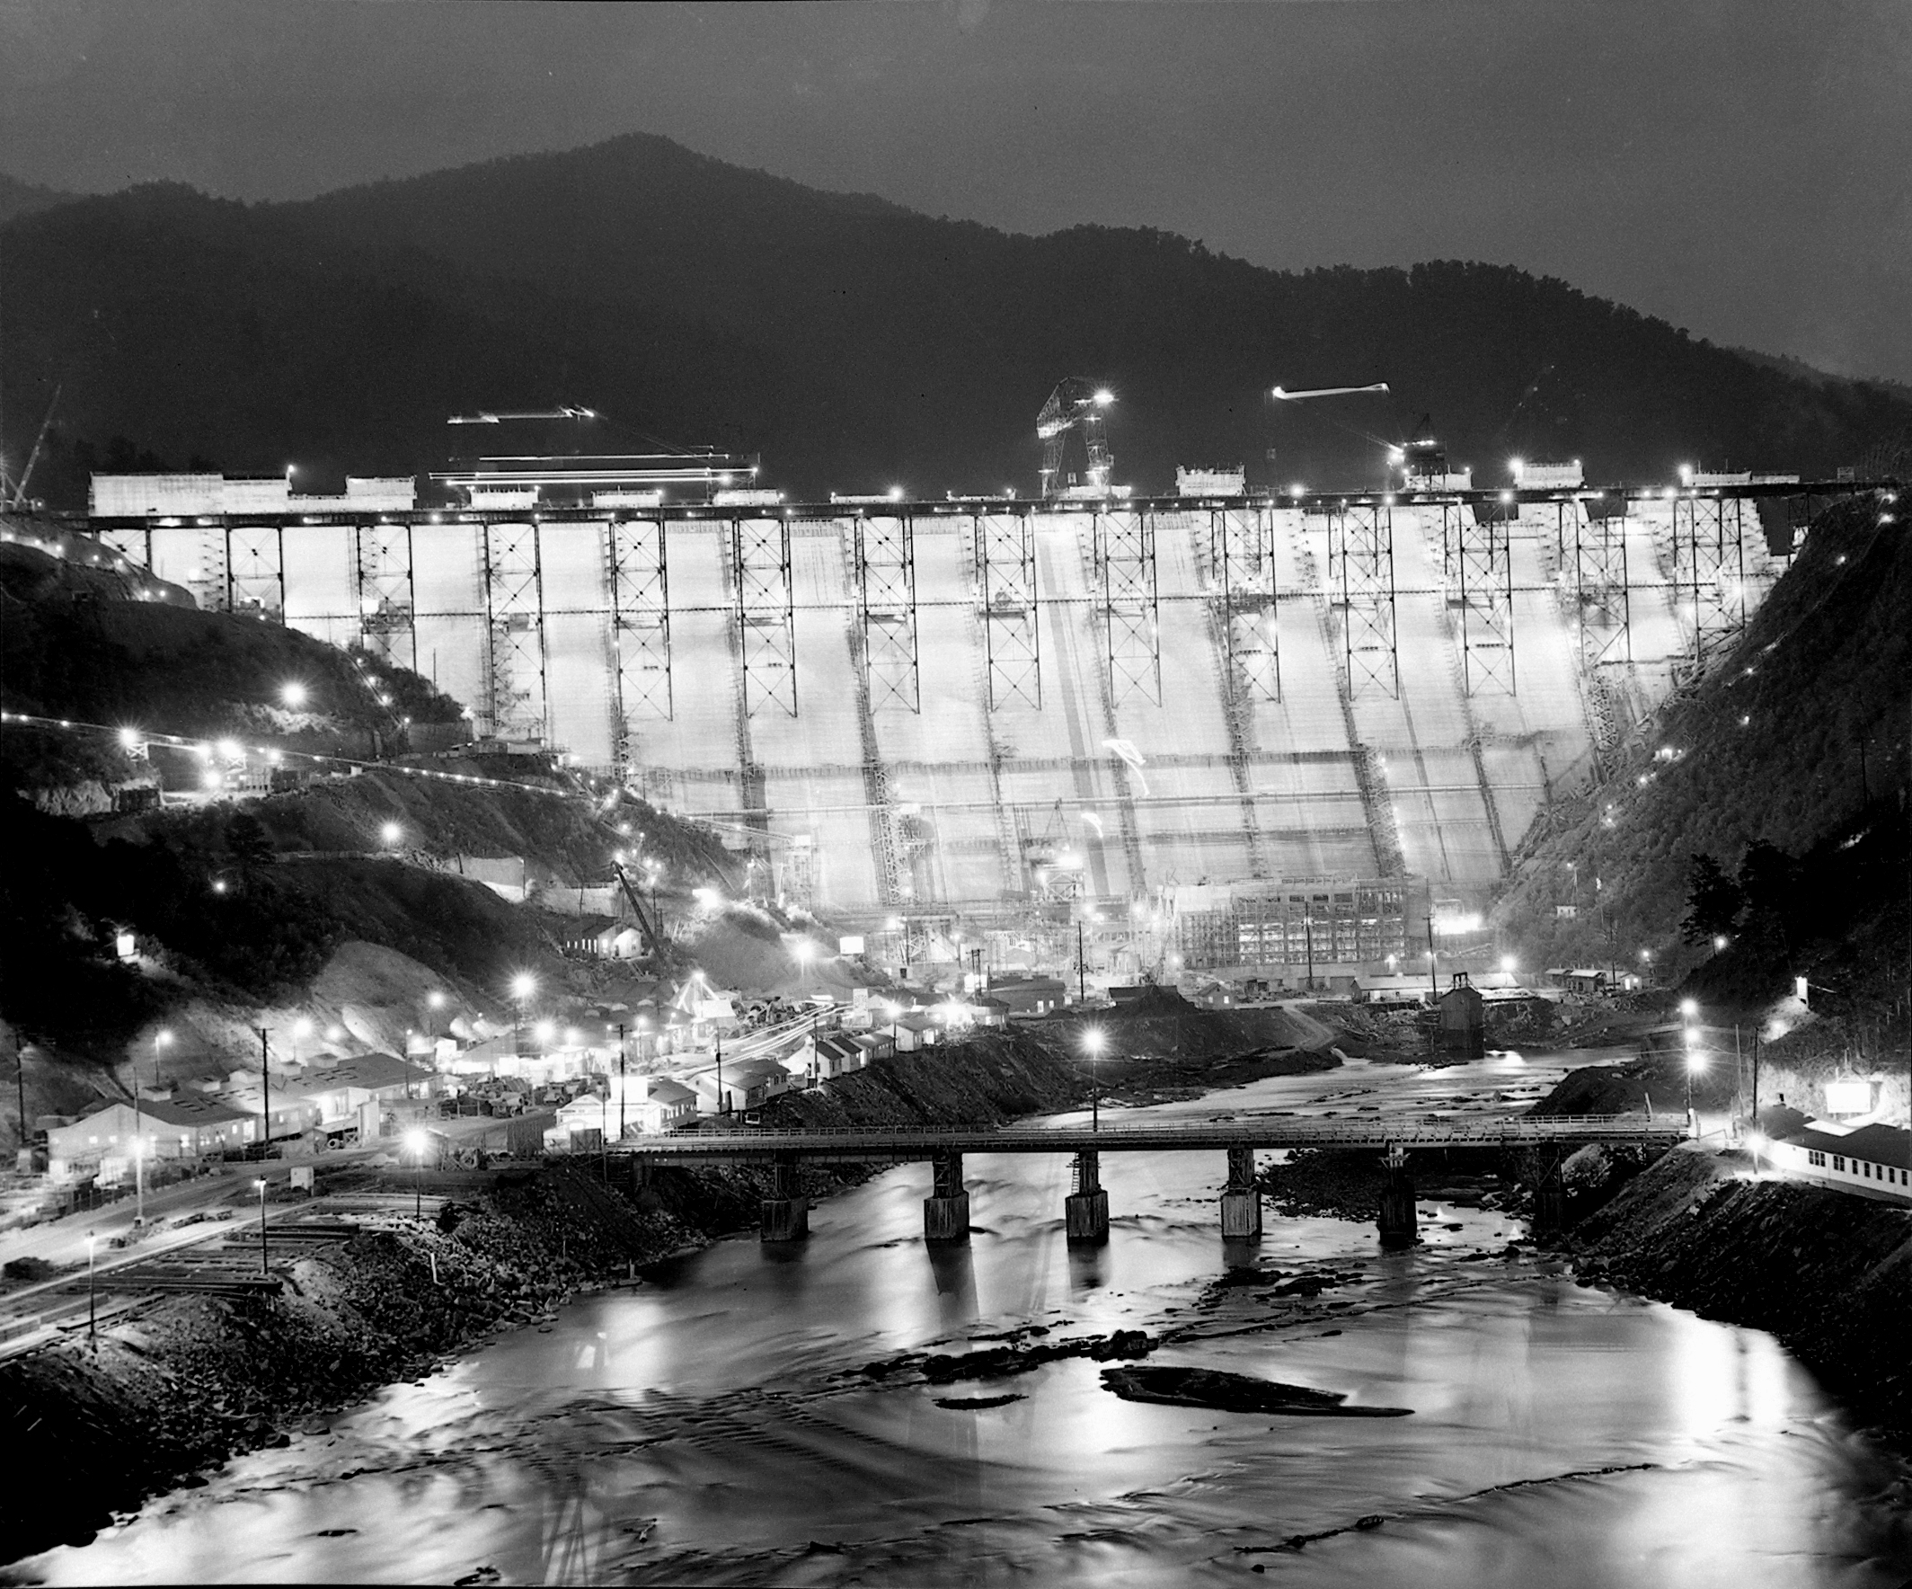
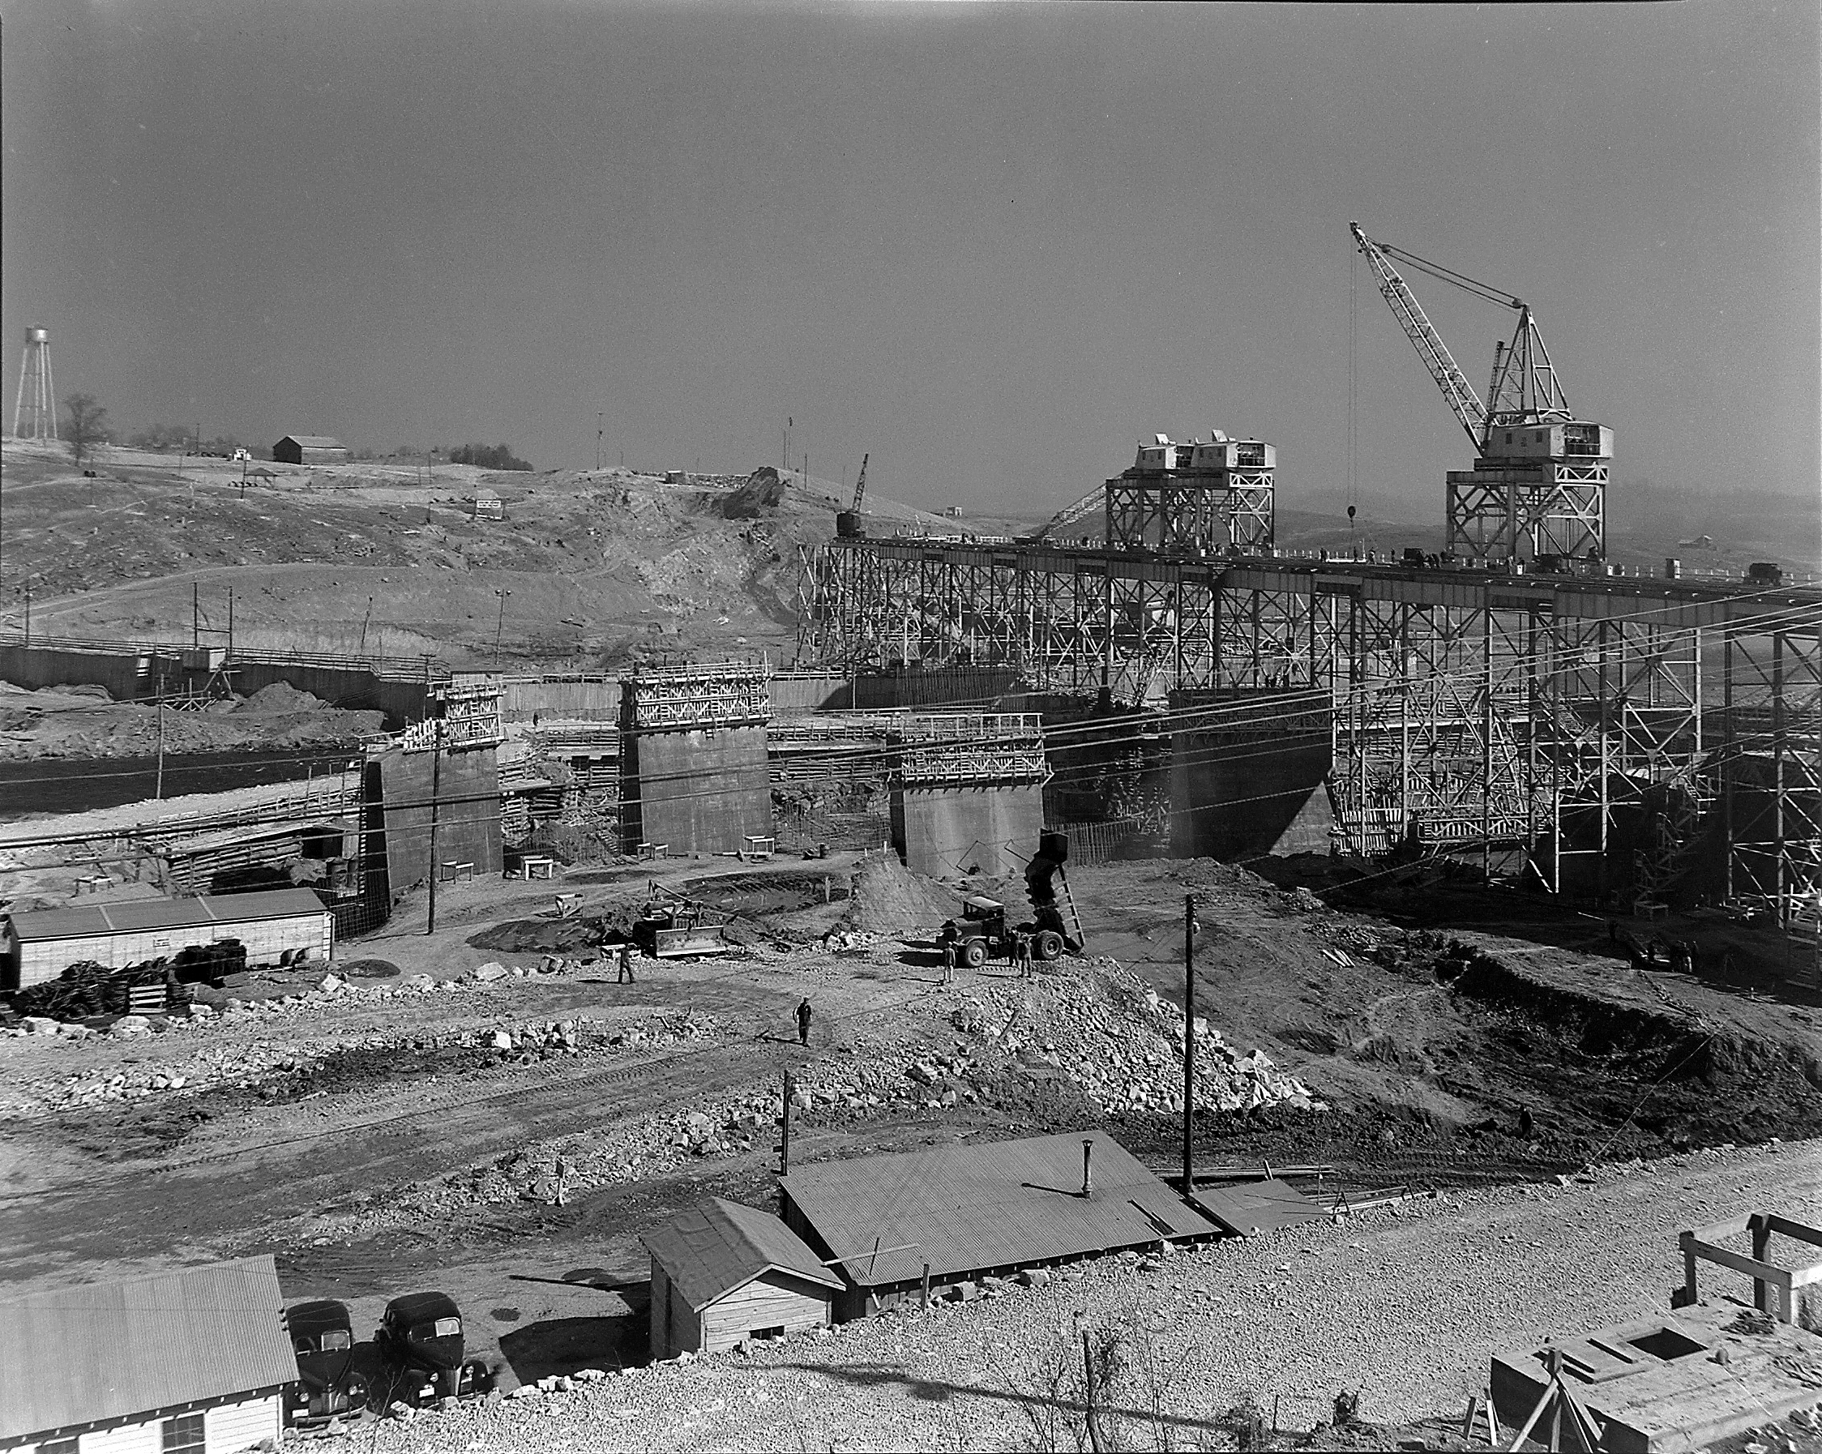
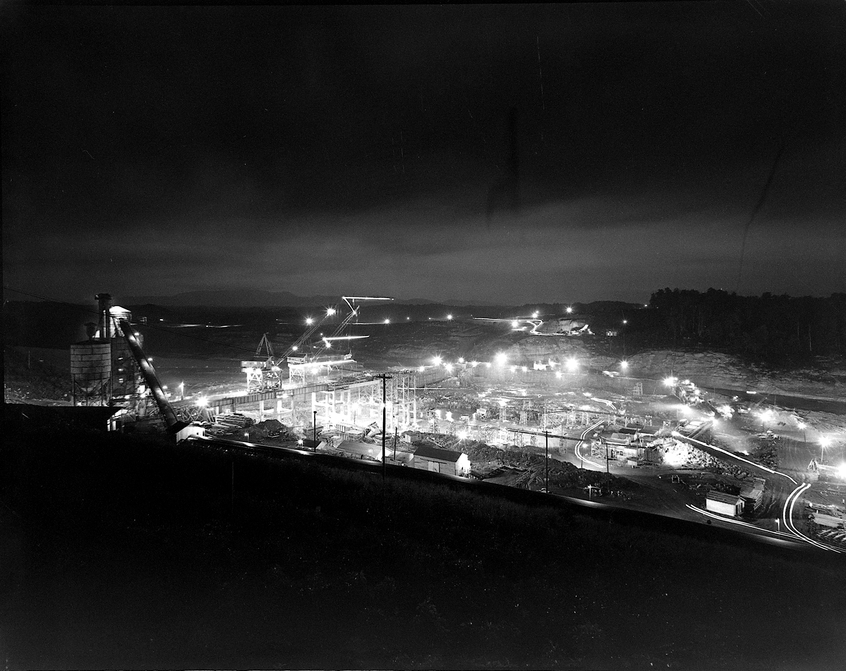

Slide 10
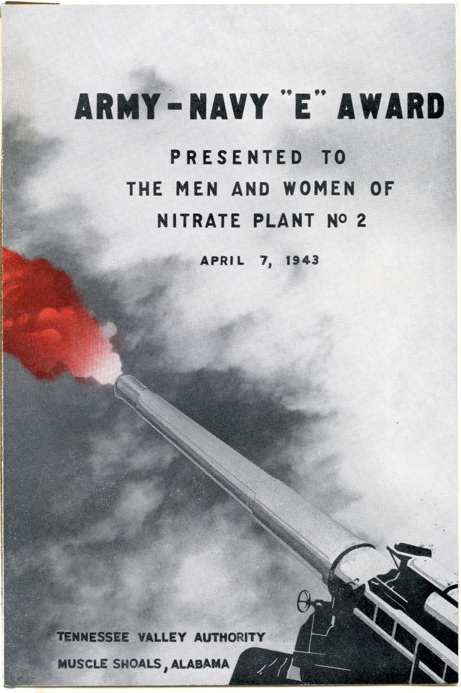
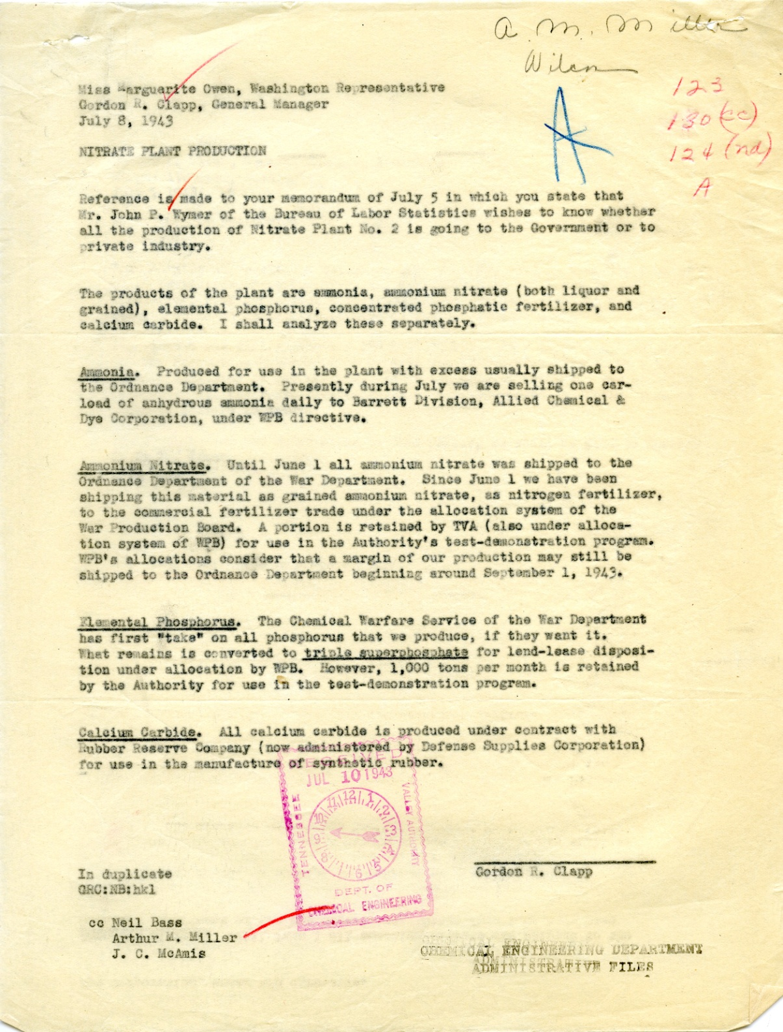
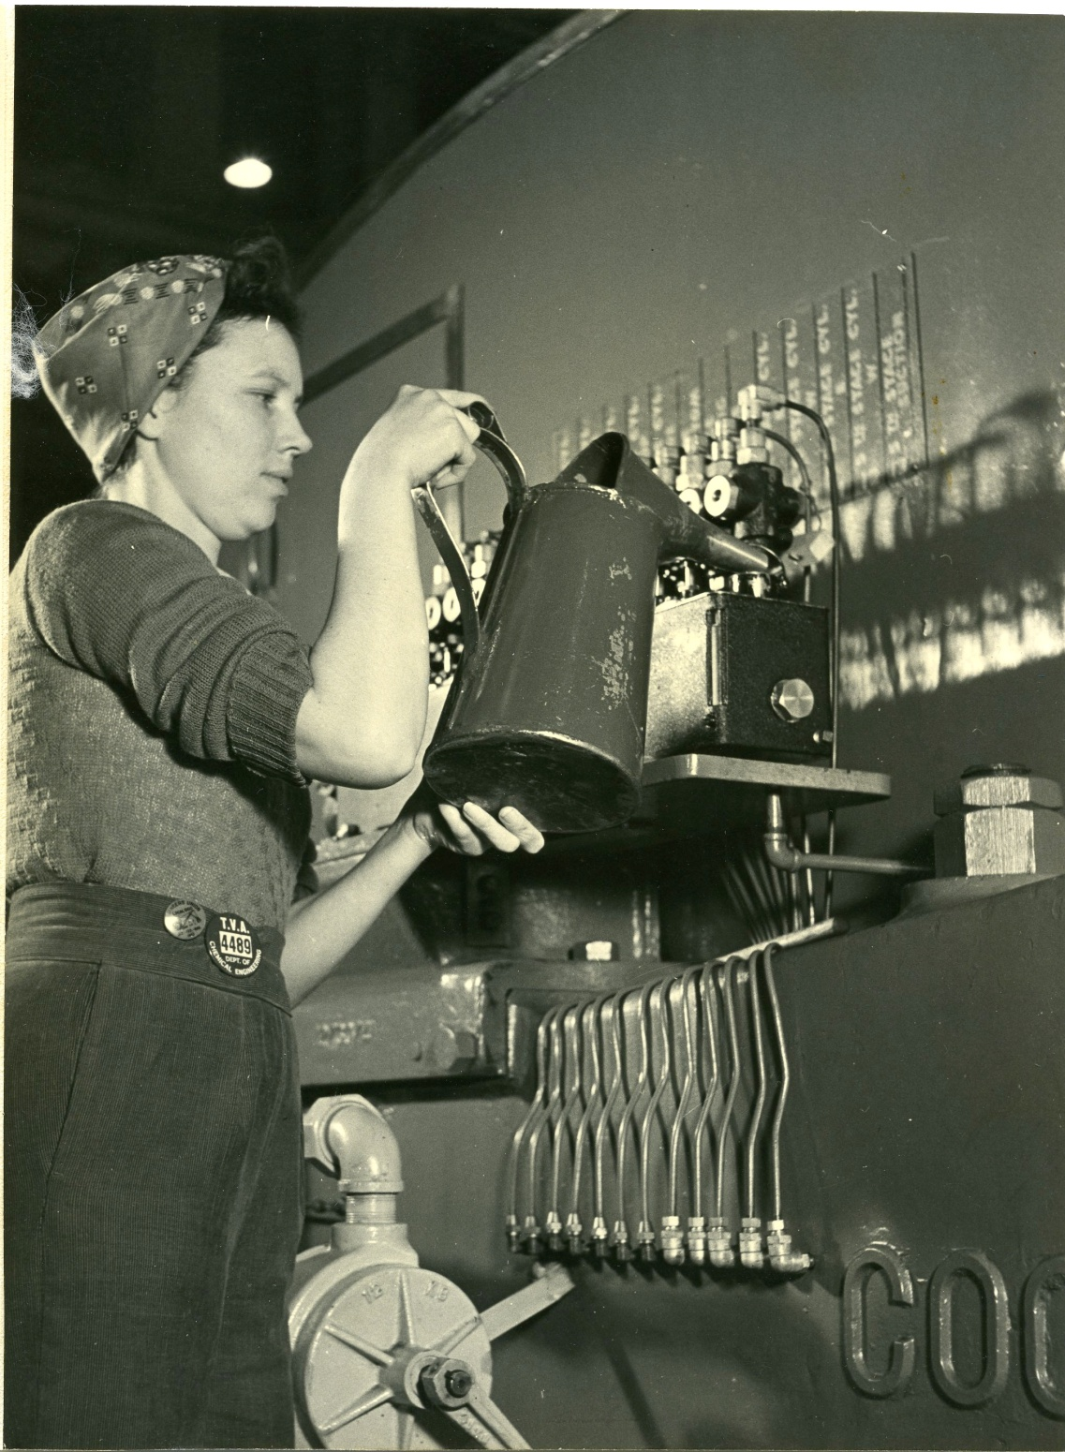
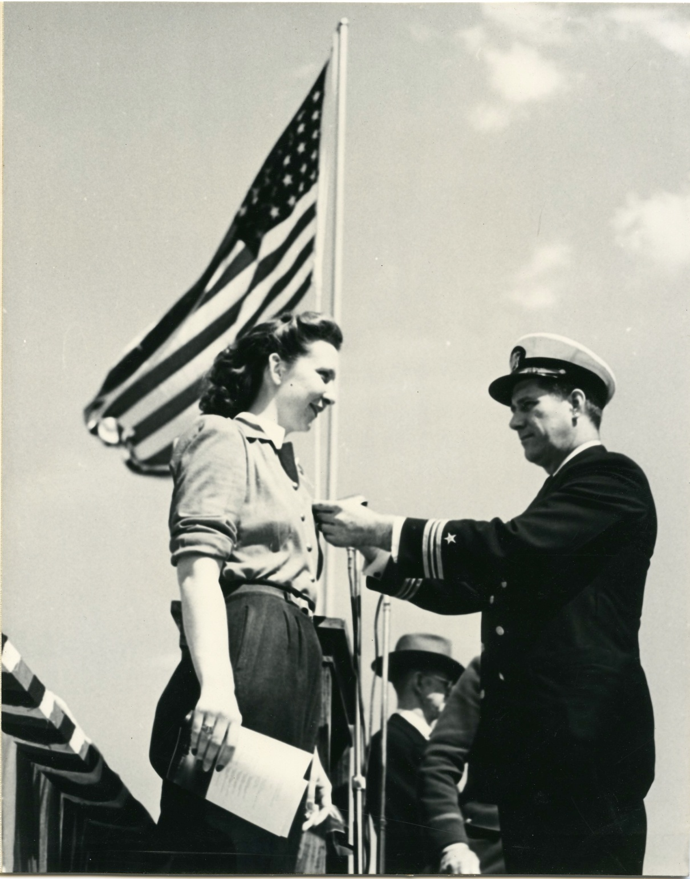
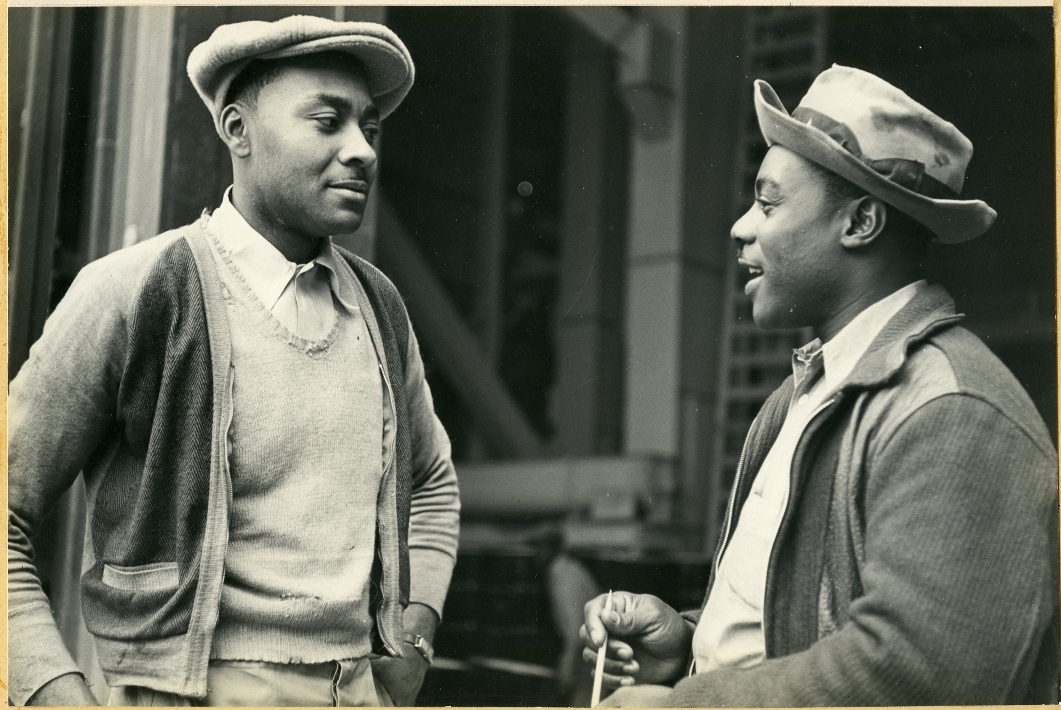
Weapons of War
RG 142
Nitrate Plant Production, 1943
Office of the General Manager Administrative Files, 1933-1957
Helen Bradford
Christine Ellege
Paul and Lincoln Johnson

Slide 11
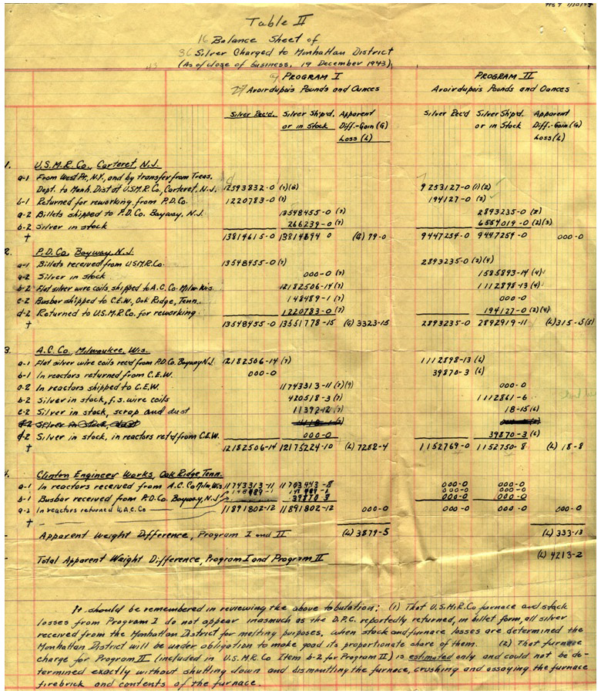
Silver from NY to TN
RG 326
Silver Distribution, December 1943
Oak Ridge Operations, Mail and Records Correspondence, 1942-1949

Slide 12
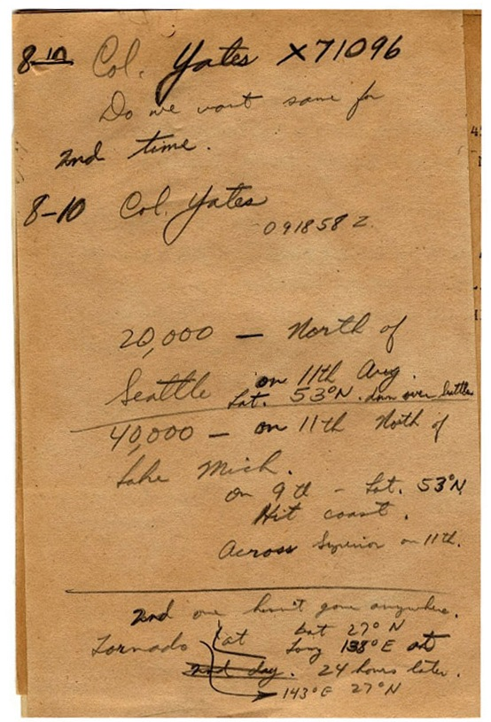
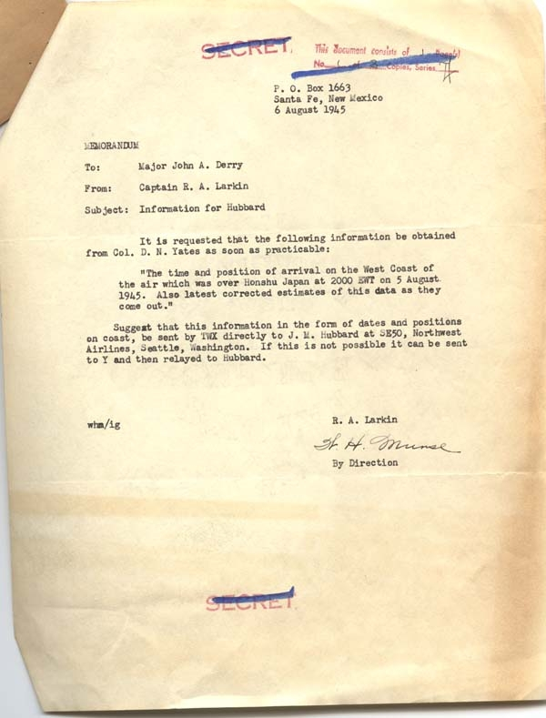
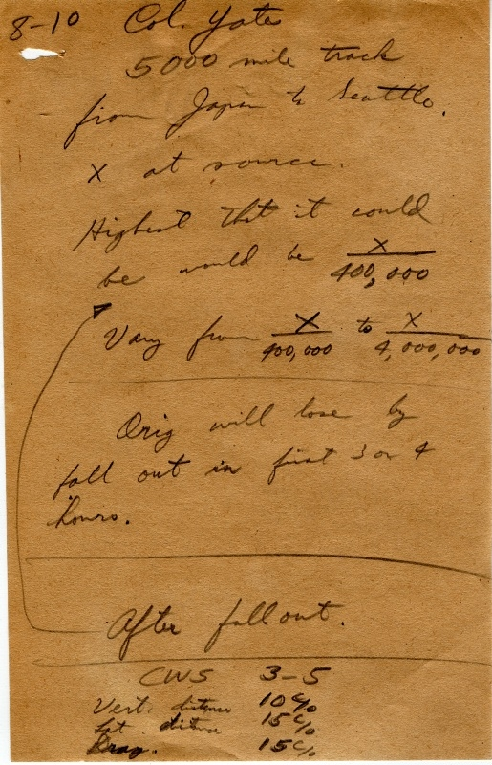
“…air over Honshu, Japan”
RG 326
Letter and Calculations, August 6, 1945
Formerly Classified Correspondence Files, 1942-1947
Finding Aid

Slide 13
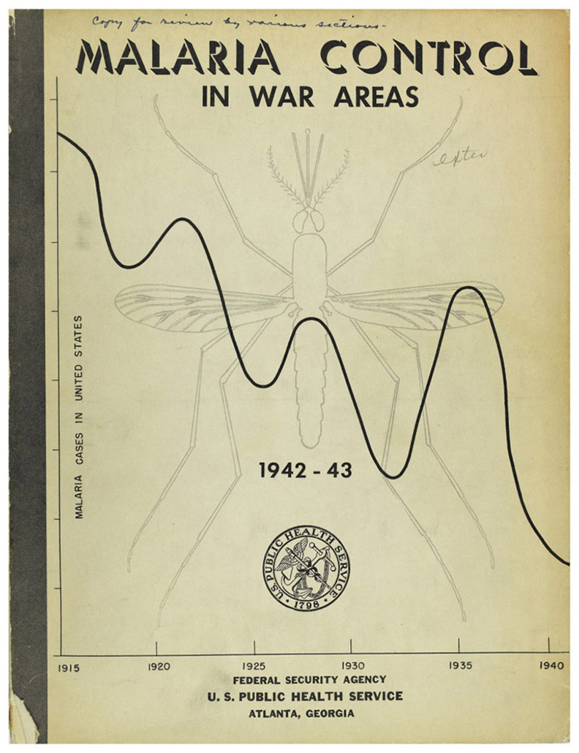
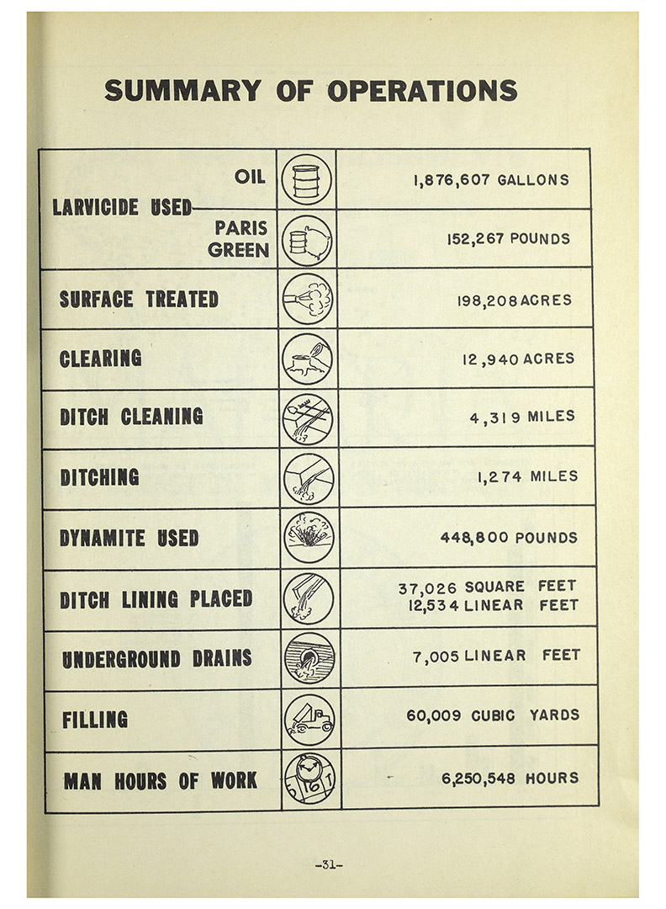
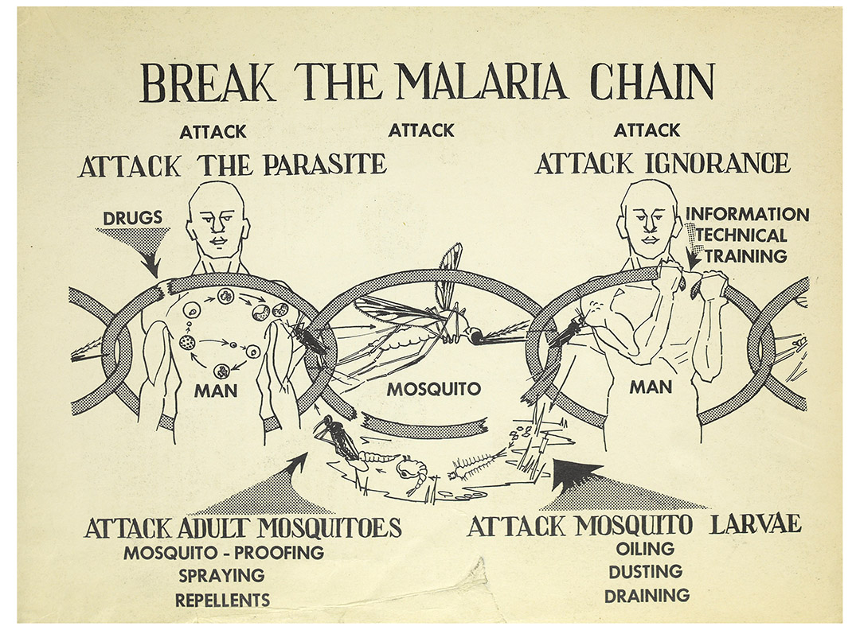
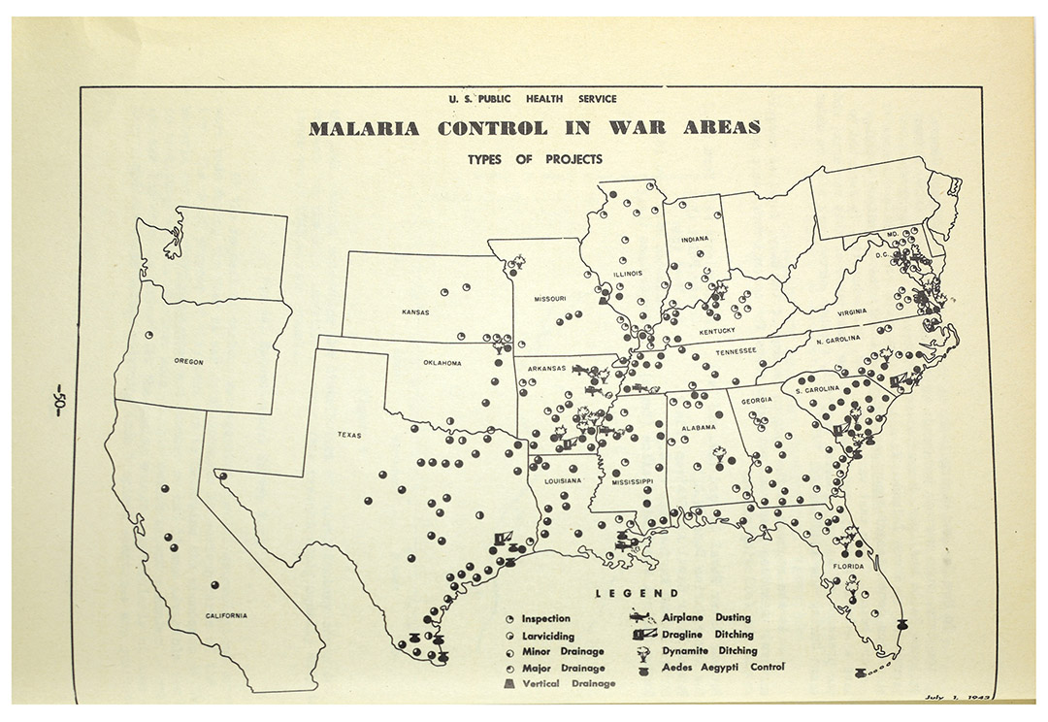
Malaria Eradication
RG 442
Malaria Control in War Areas, 1942-1943
Historical Files, 1918-1996

Slide 14
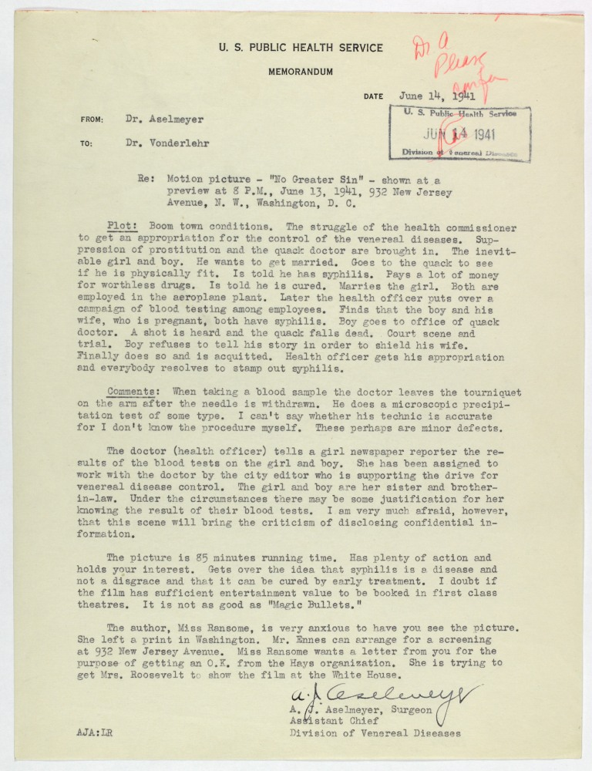
VD Education
RG 442
No Greater Sin, 1941
Bacterial Diseases, VD Branch, 1931-1961

Slide 15
civil rights

Slide 16
Documenting Civil Rights
RG 142 – Tennessee Valley Authority
Worker strikes, office directives
RG 156 – Chief of Ordnance
Photographs, employment statistics, incident reports
RG 211 – War Manpower Commission
Employment discrimination cases, worker strikes and riots
RG 219 – Defense Transportation
Segregated transit
RG 228 – Commission on Fair Employment Practices
Equal employment directives, complaints, and investigations
RG 270 – War Assets Administration
Property data for government installations

Slide 17
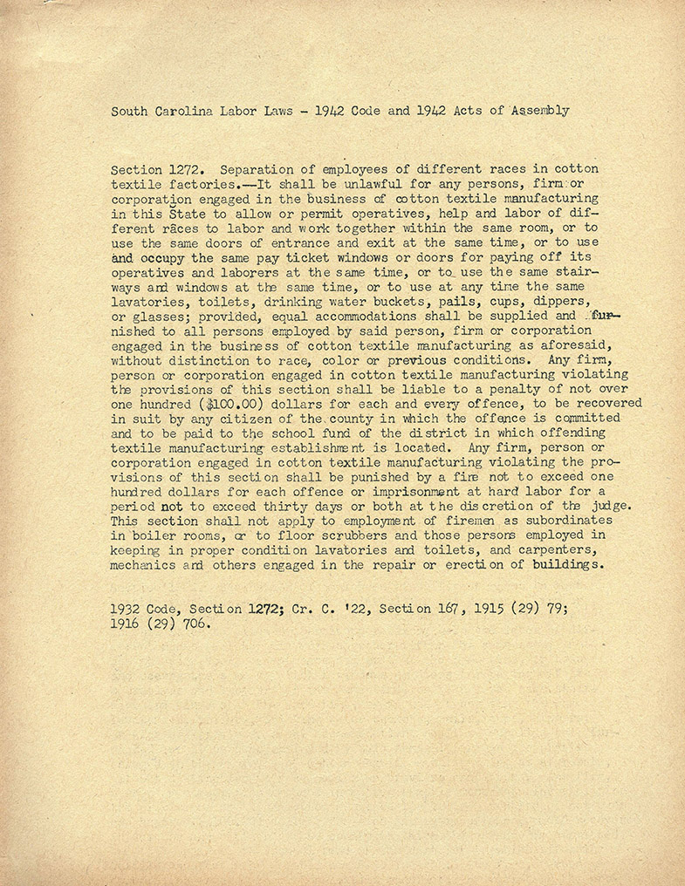
Ordered Segregation
RG 211
South Carolina Textile Factories, 1942
Progress and Activity Reports, 1943-1945
Folder list available

Slide 18
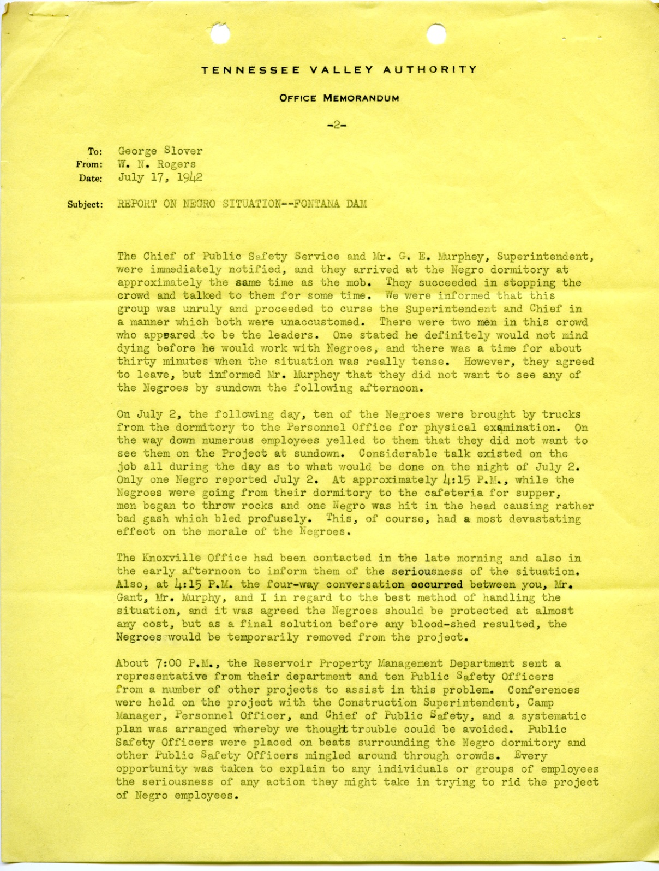
Intimidation at the worksite
RG 142
Fontana Dam Project, 1942
Personnel Correspondence, 1933-1943
Folder list available

Slide 19
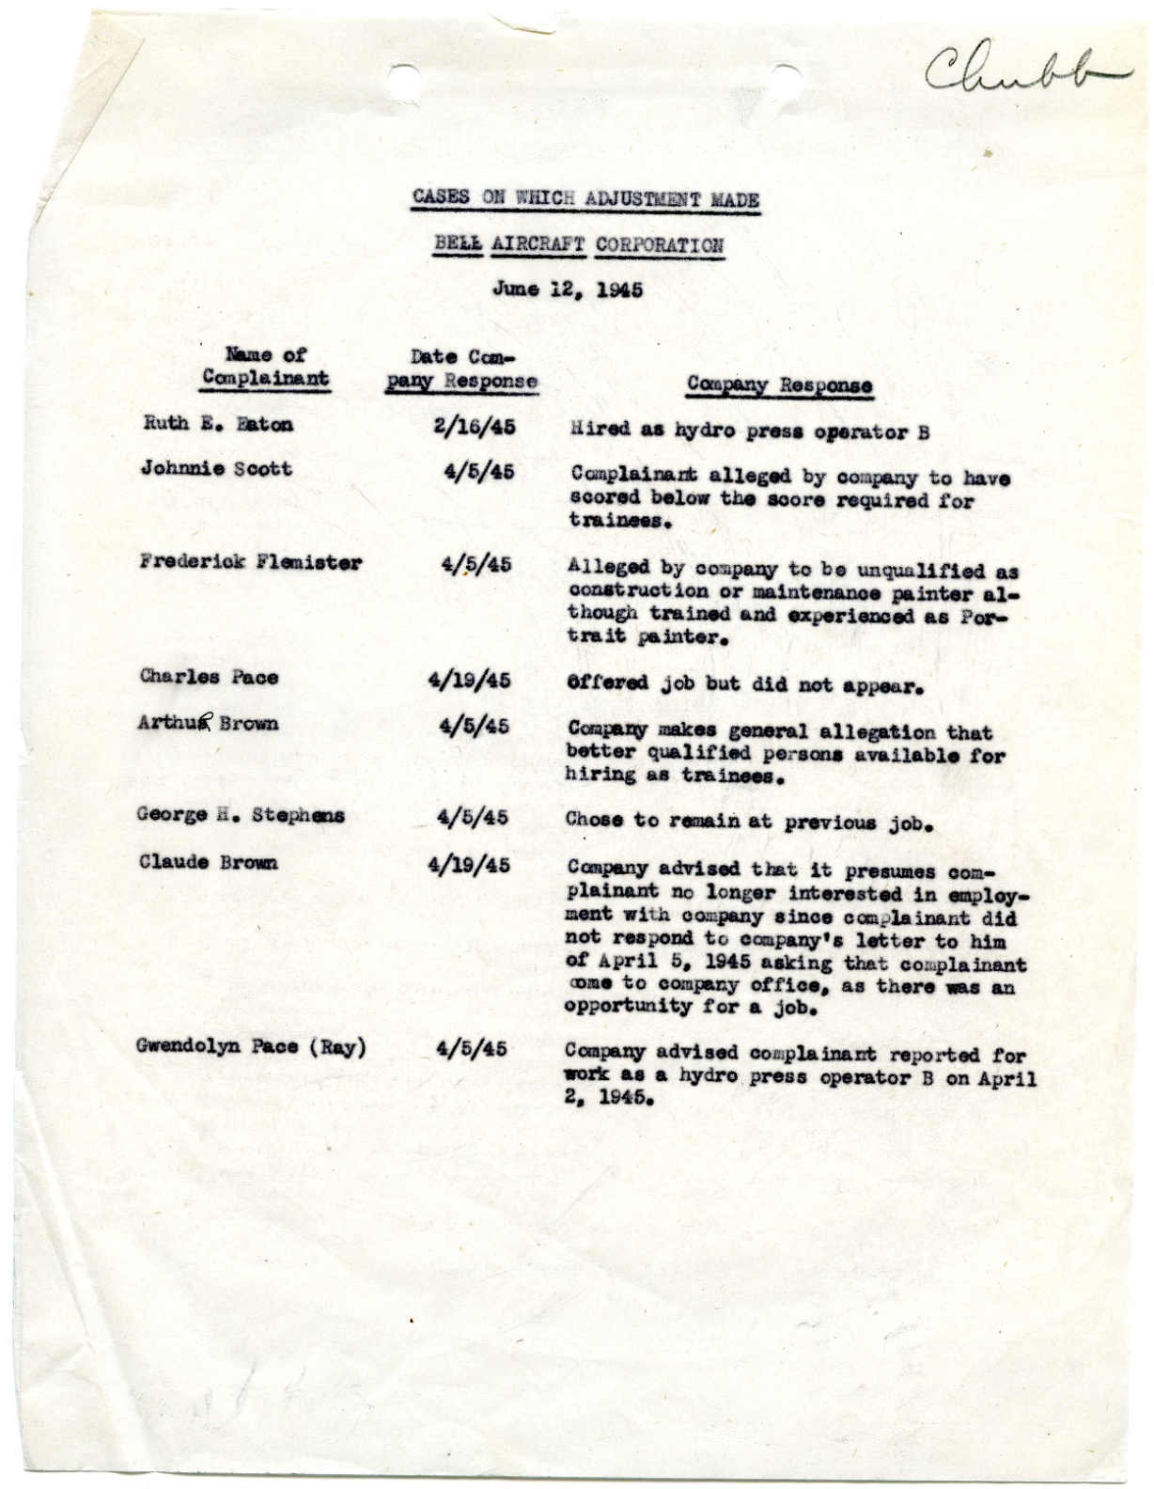
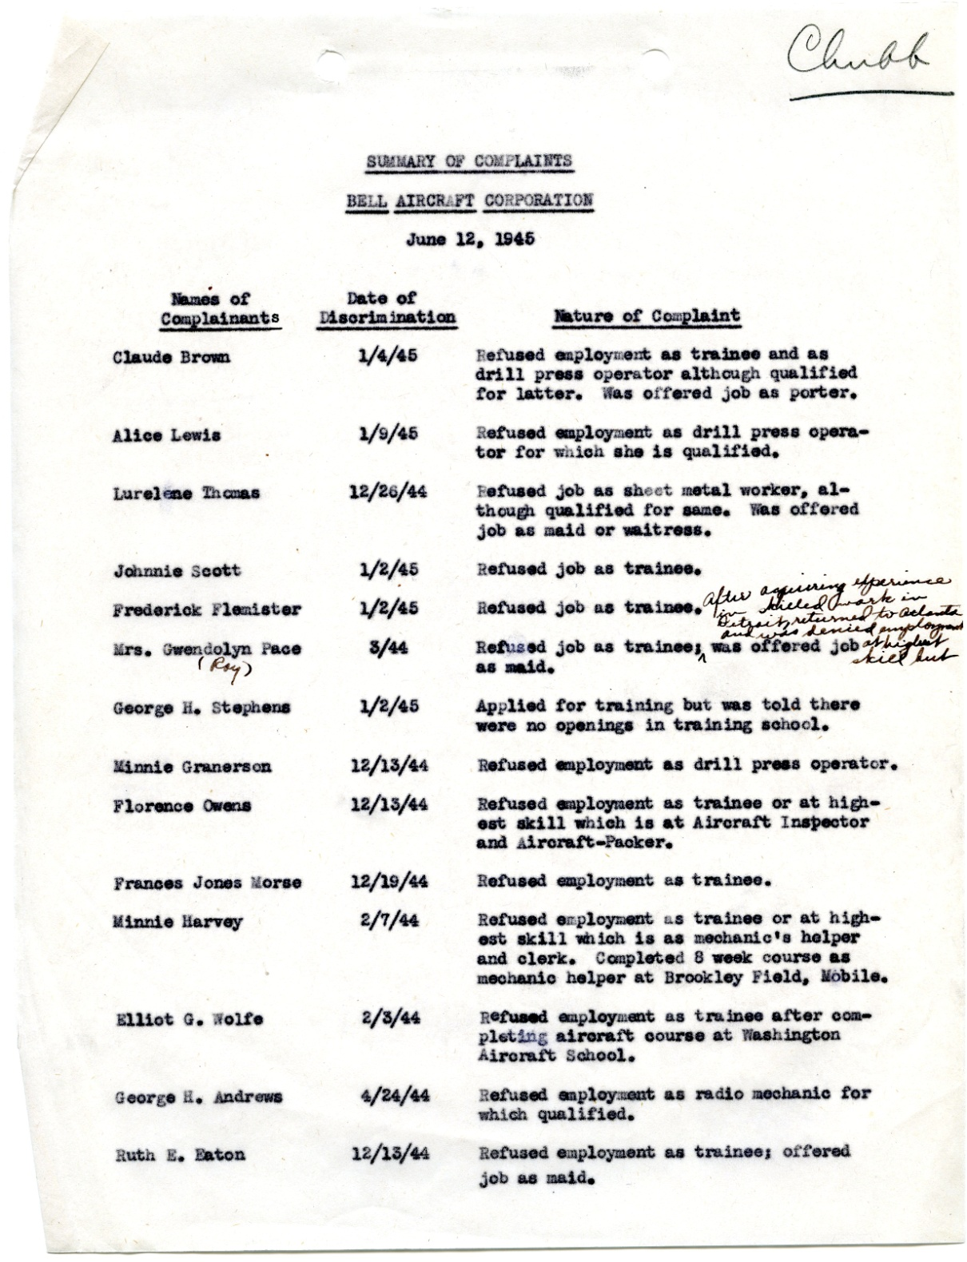
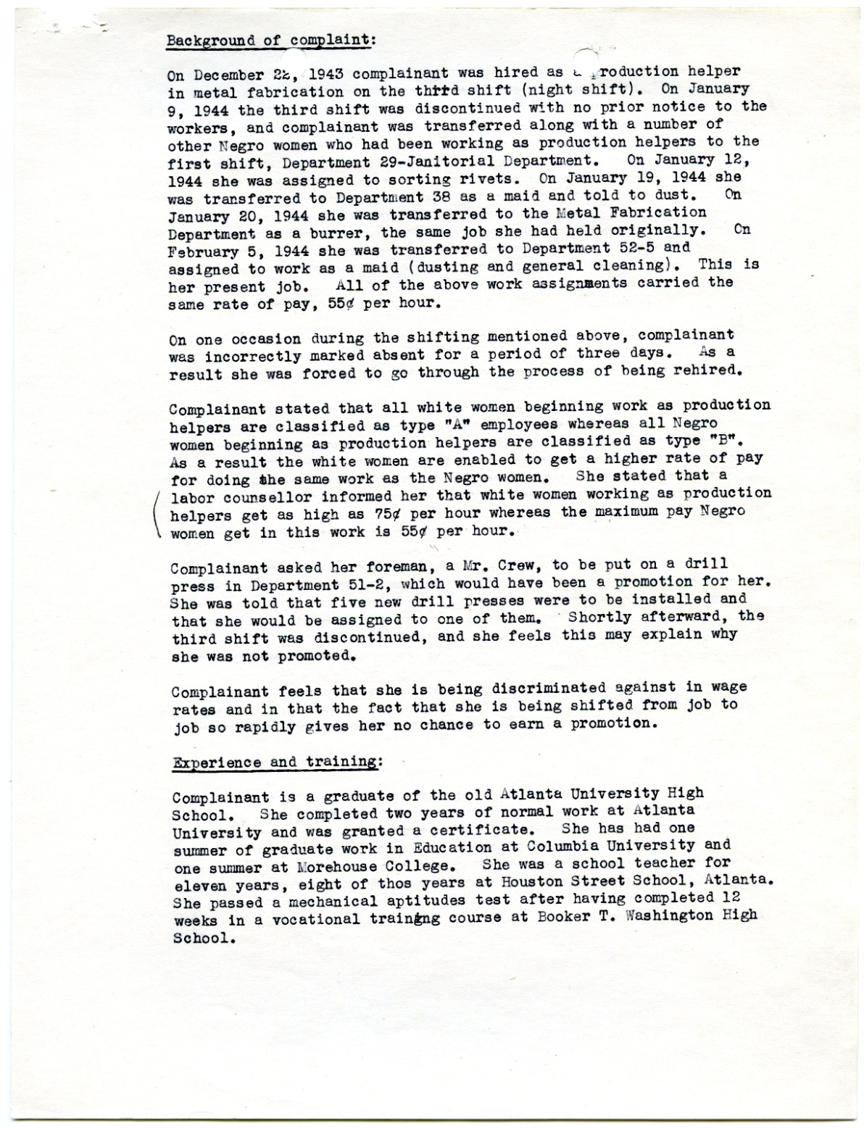
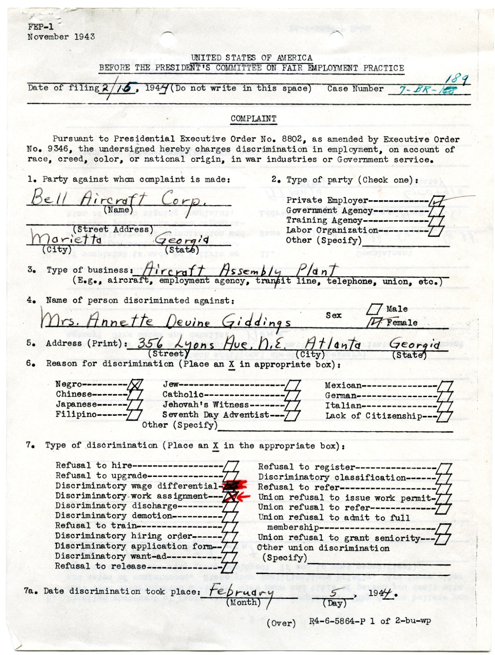
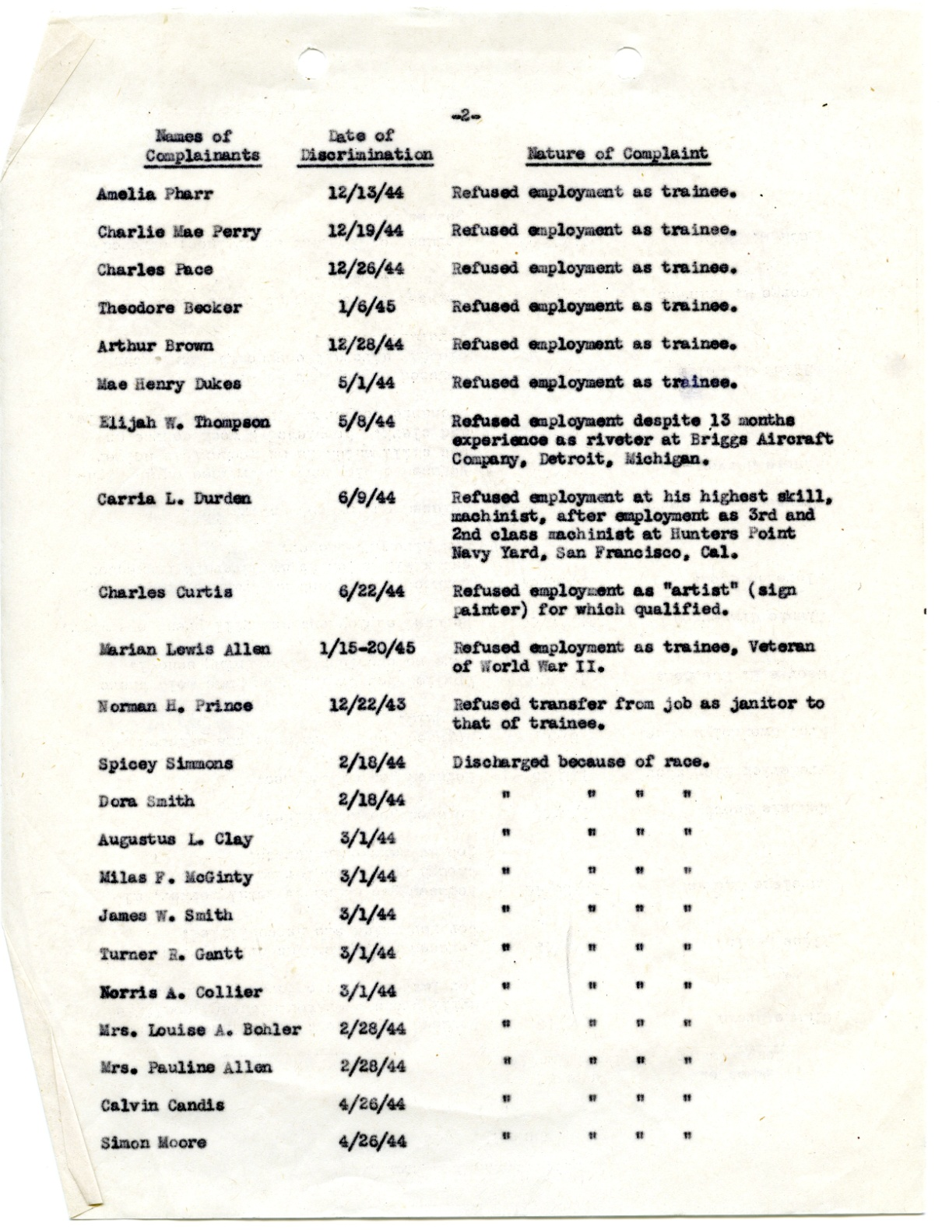
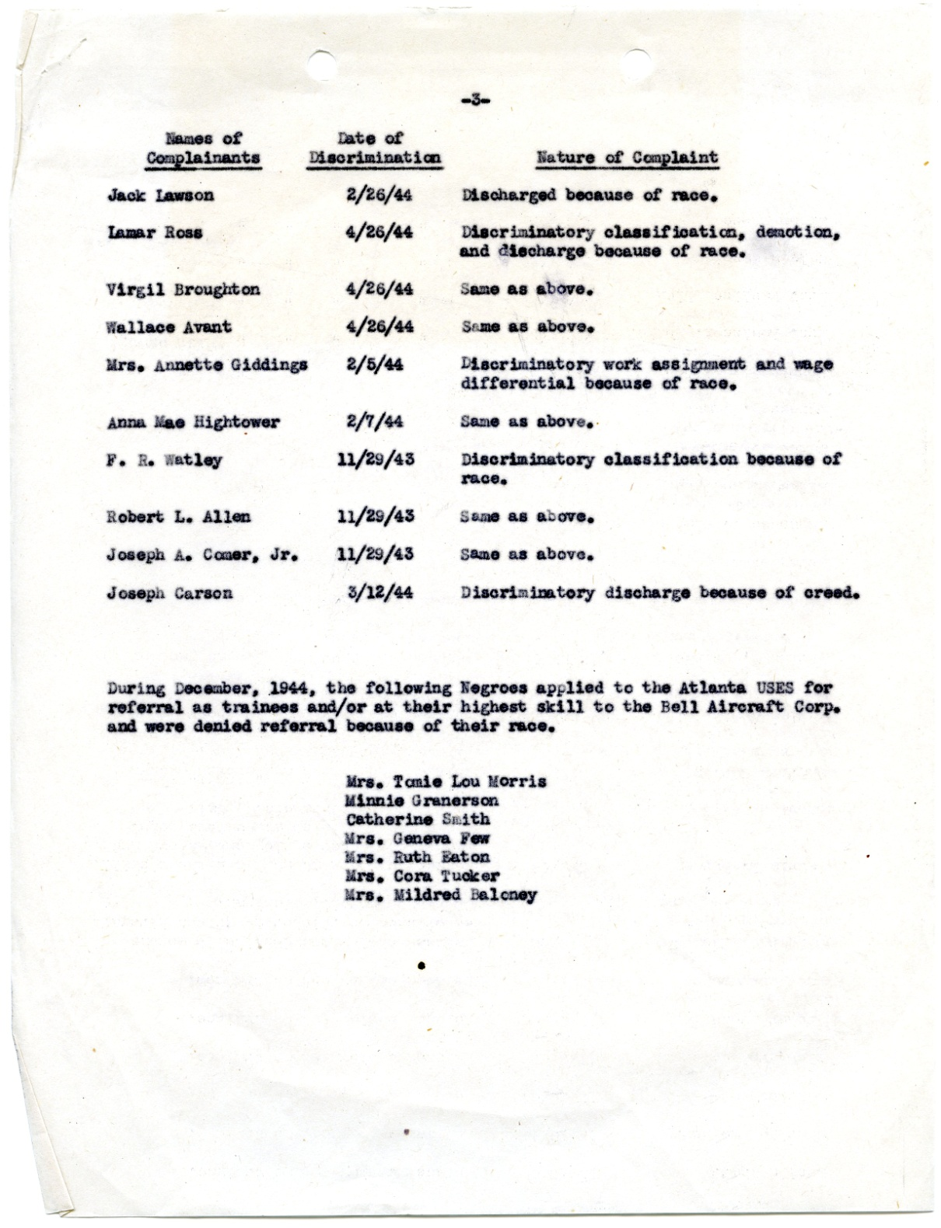
Government Intervention
RG 228
Bell Bomber Plant Complaints, 1944-1945
FEPC Closed Cases, 1941-1946

Slide 20
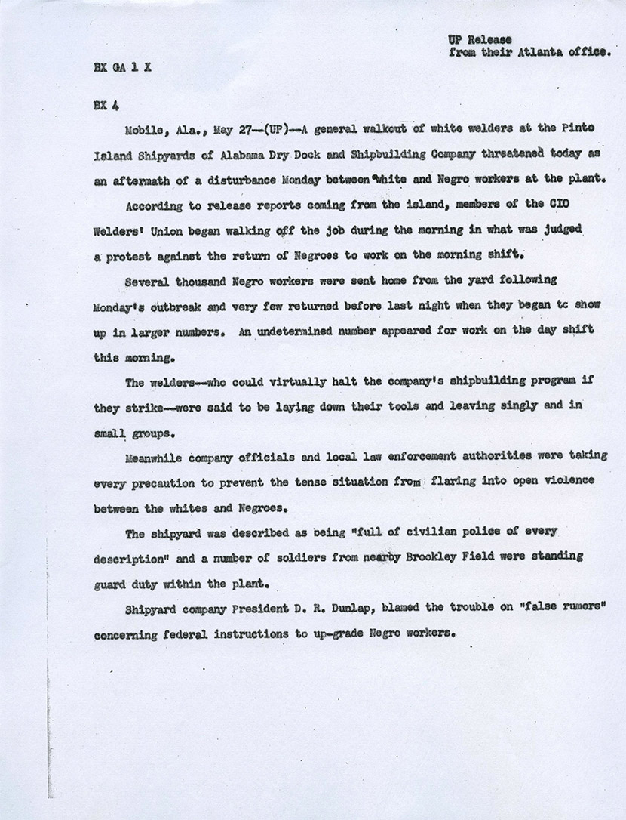
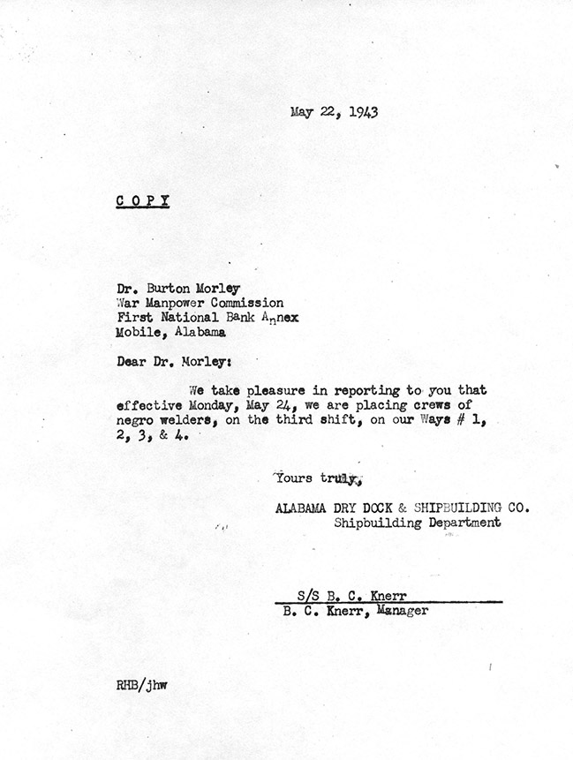
Equal Employment
RG 211
Reaction at the Alabama Dry Dock, 1943
Speeches by Members of Regional Office Staff, 1943-1945
Folder list available

Slide 21
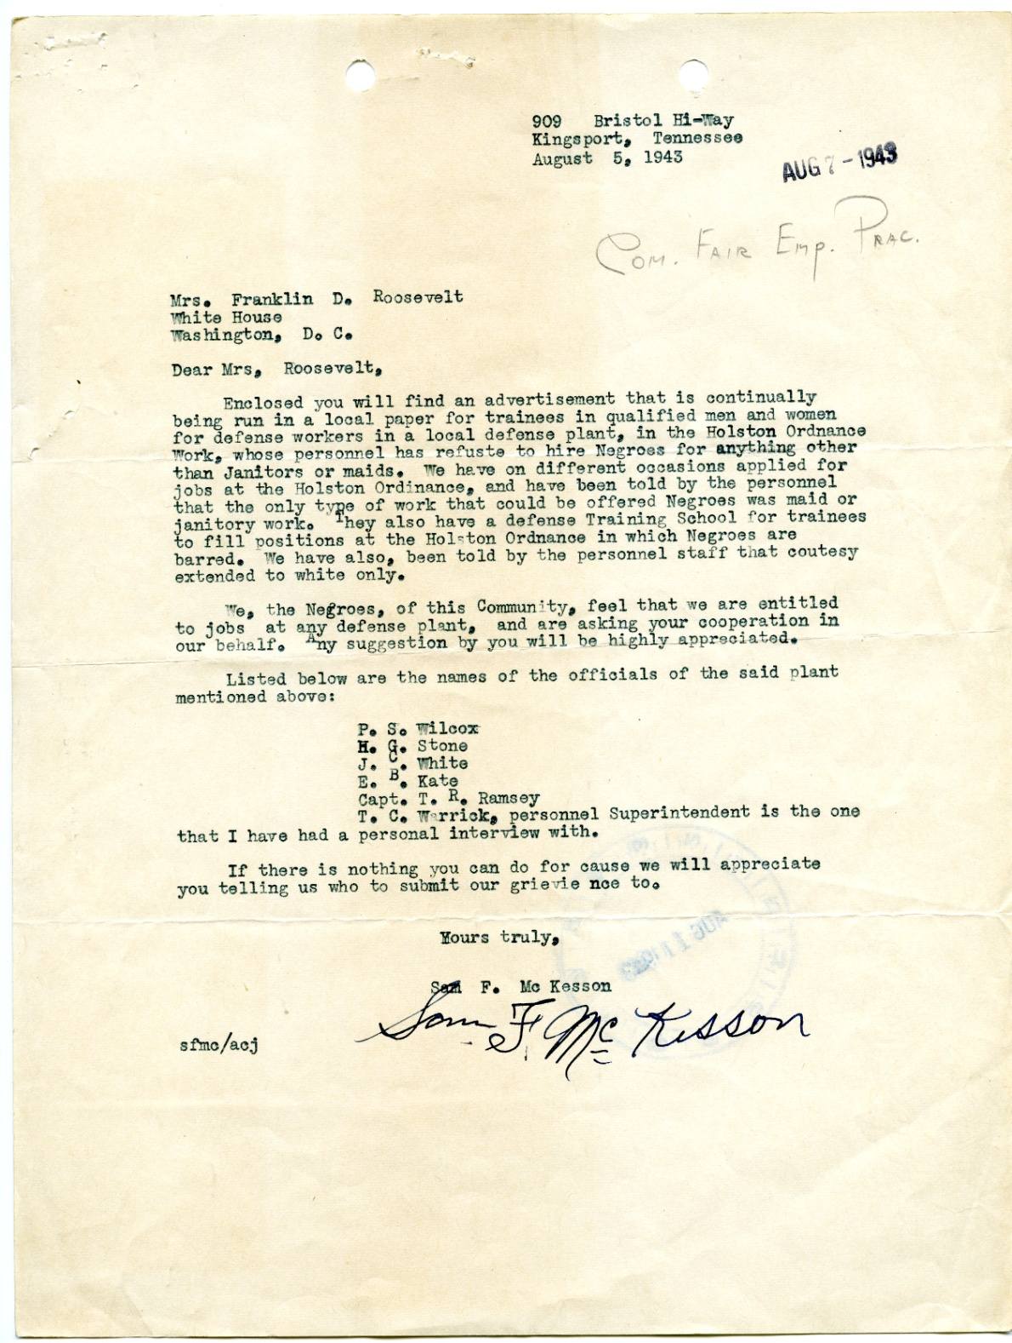
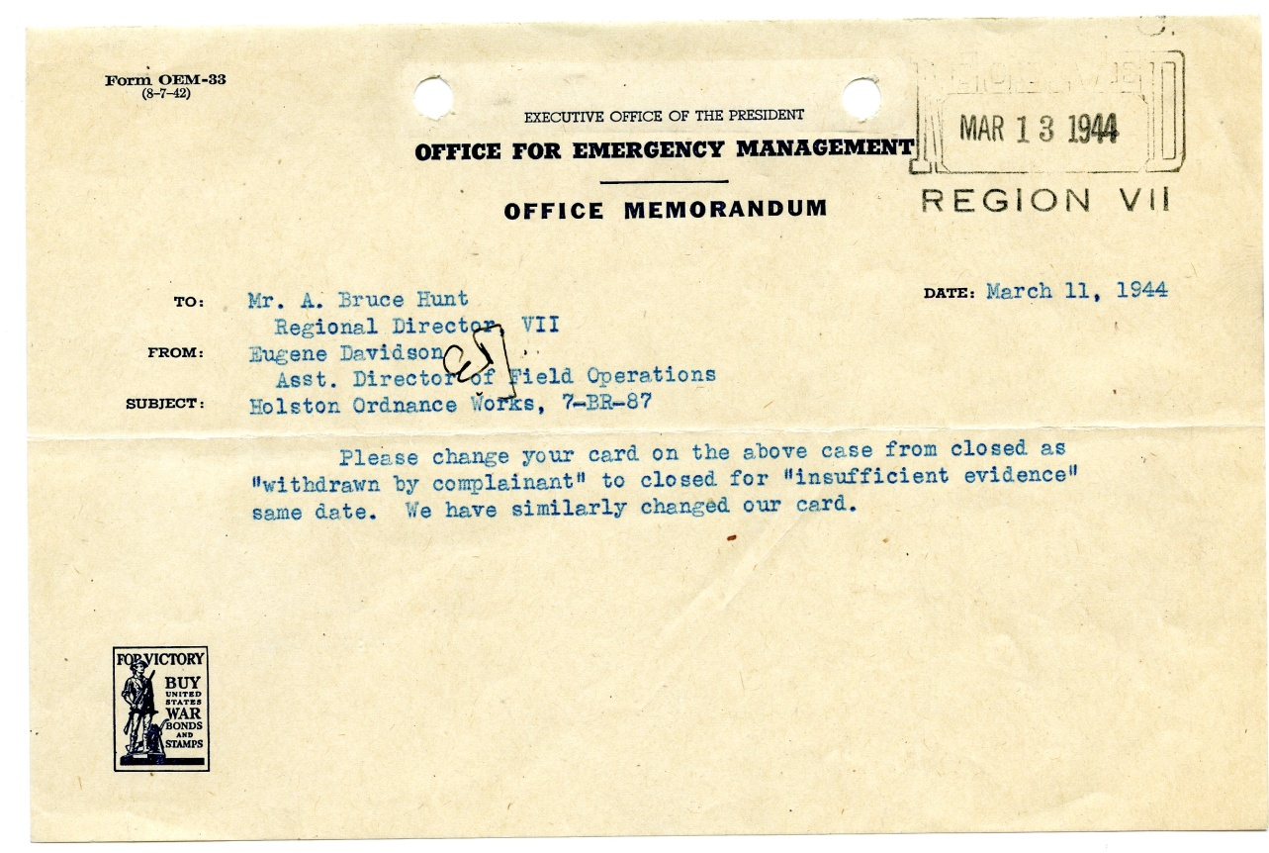
“Insufficient evidence”
RG 228
Complaint at Holston Ordnance Works, 1943
FEPC Closed Cases, 1941-1946

Slide 22
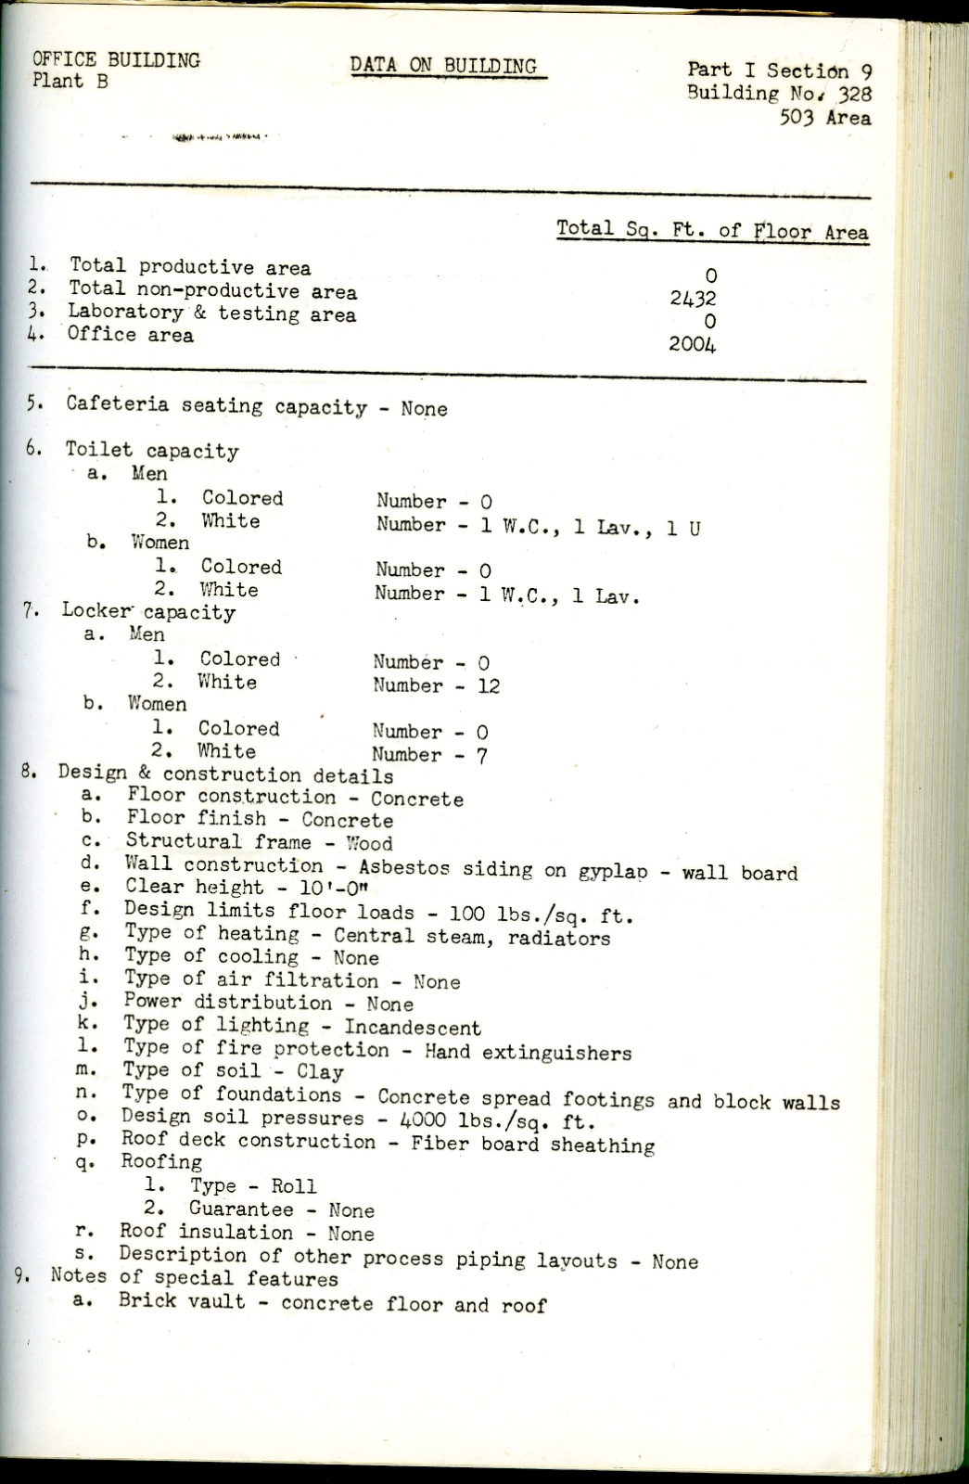
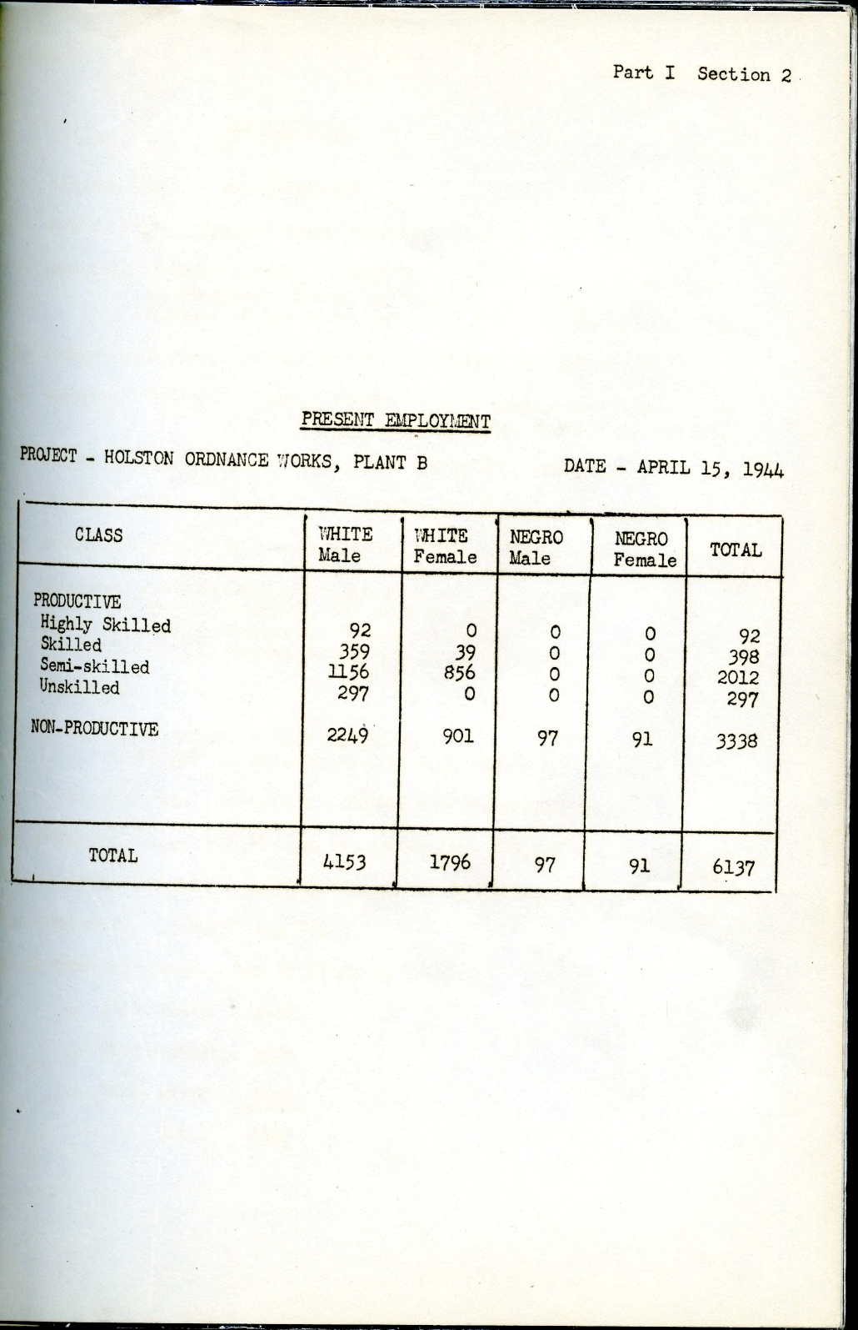
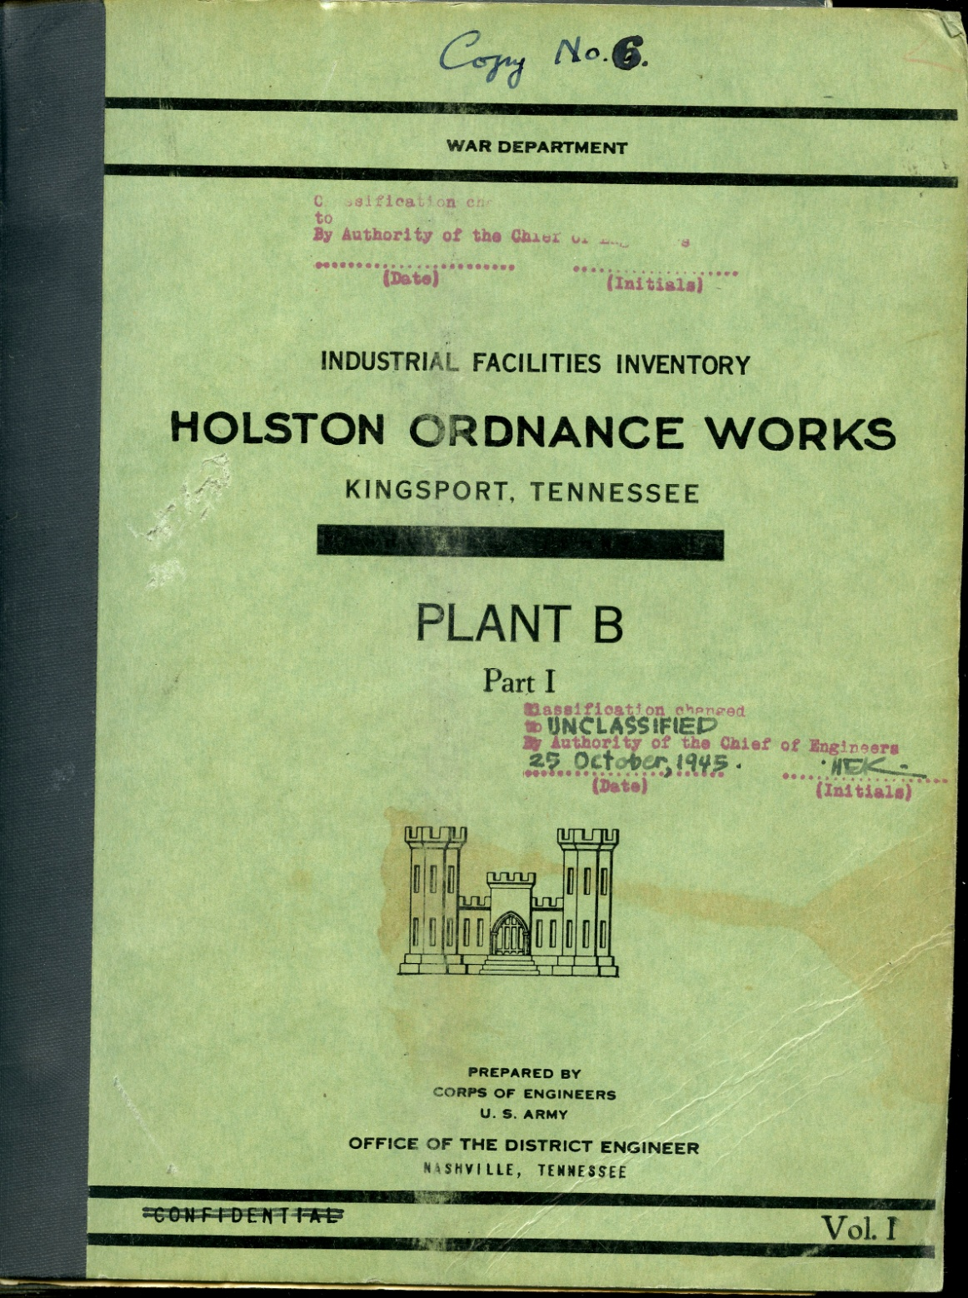
Evidence in the Archives
RG 270
Building and Employment Data - Holston Ordnance Works, 1944
Unrelated Property Section Files,
1946-1949

Slide 23
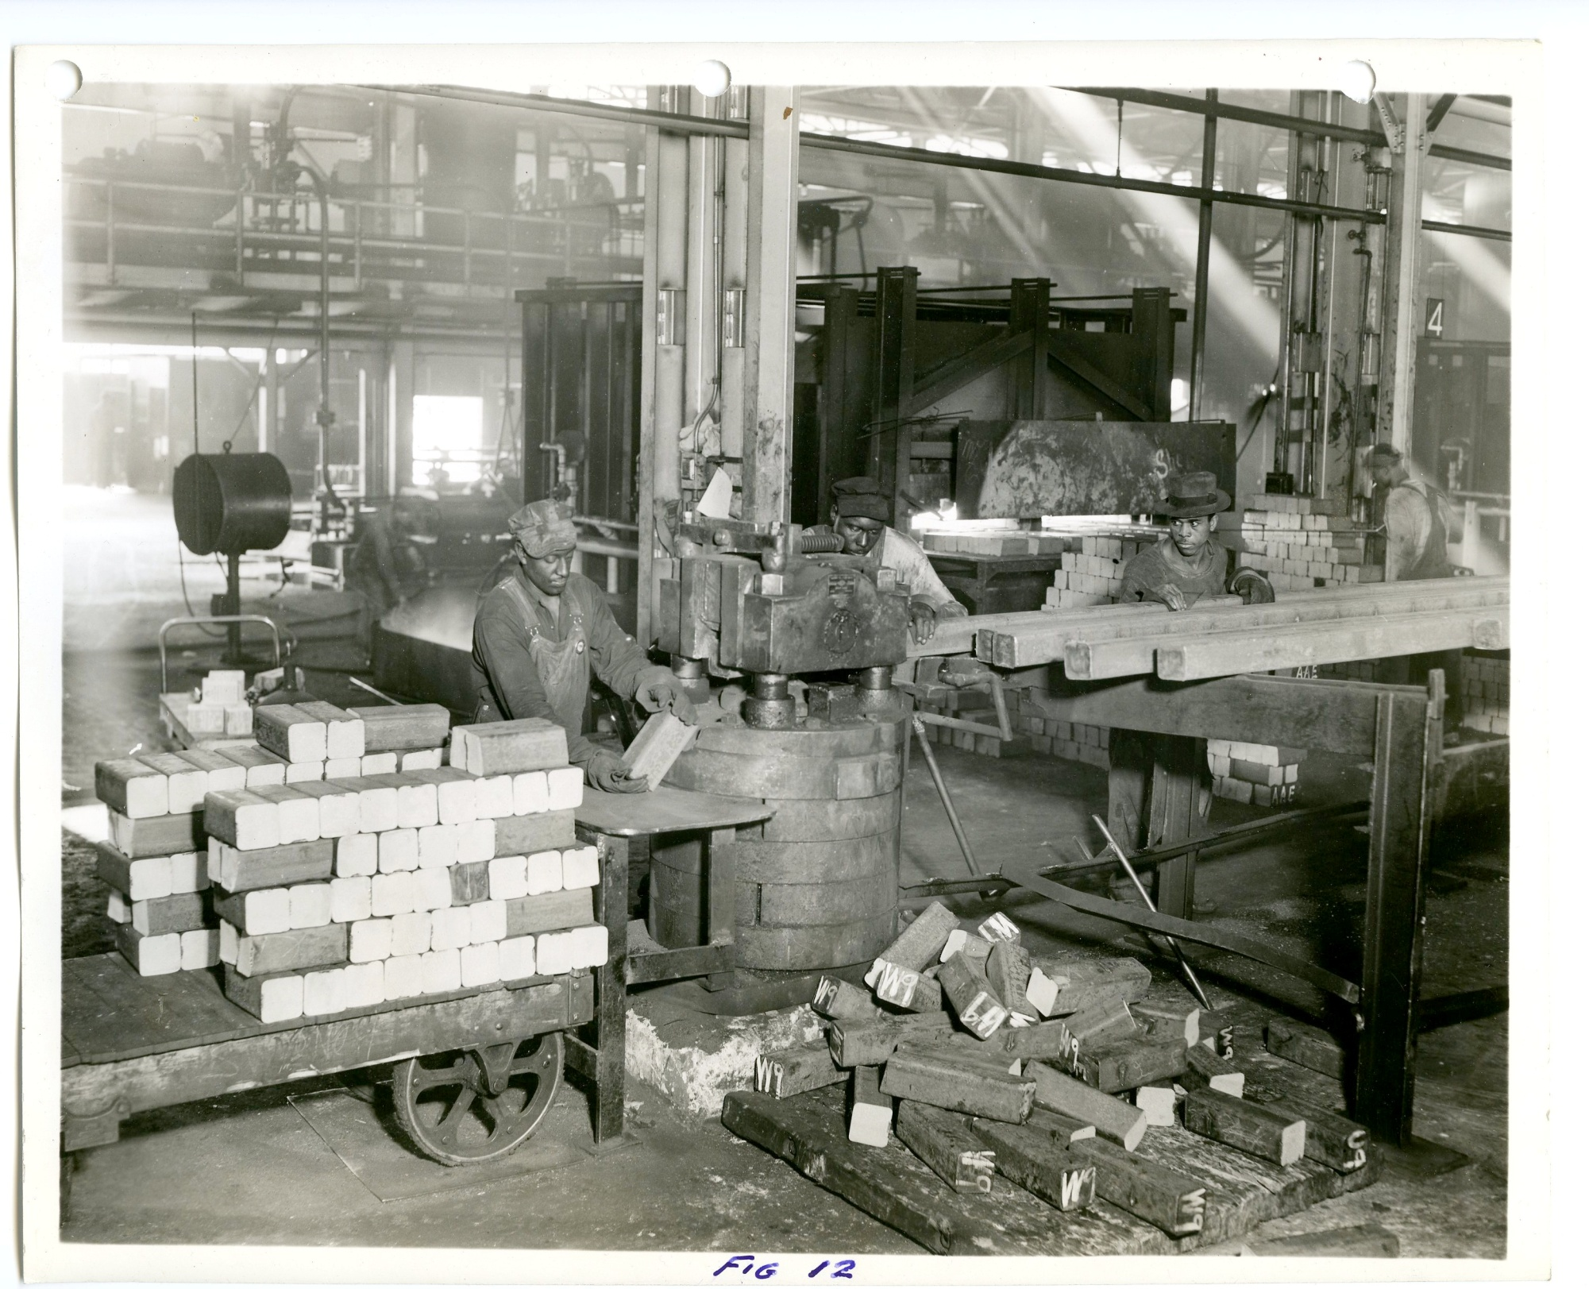
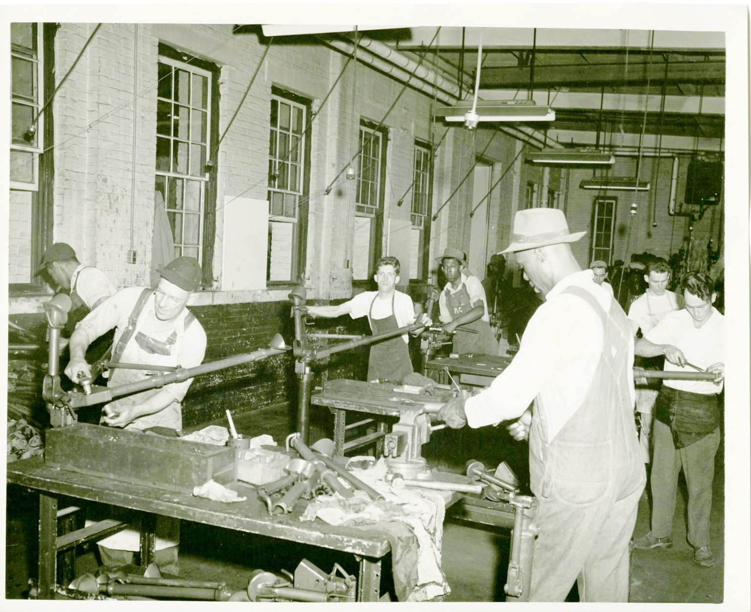
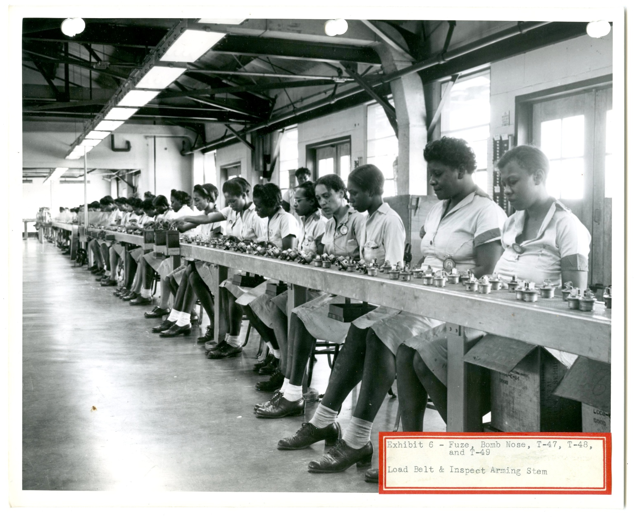
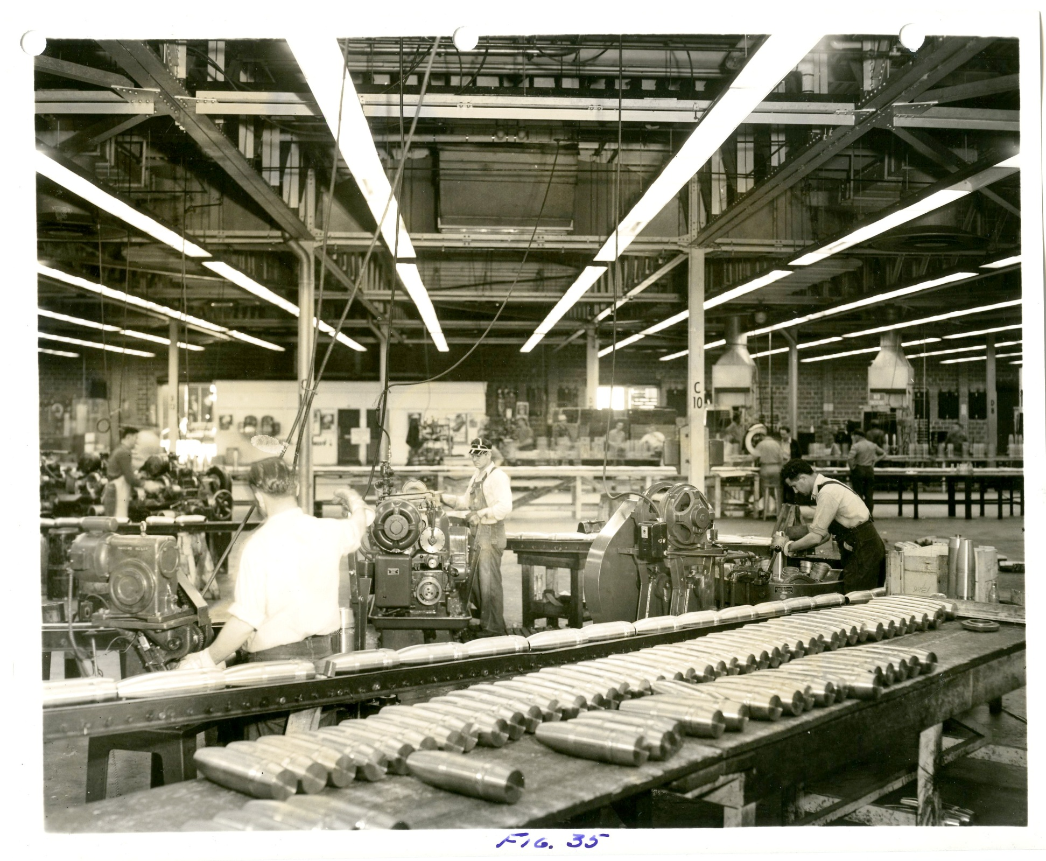
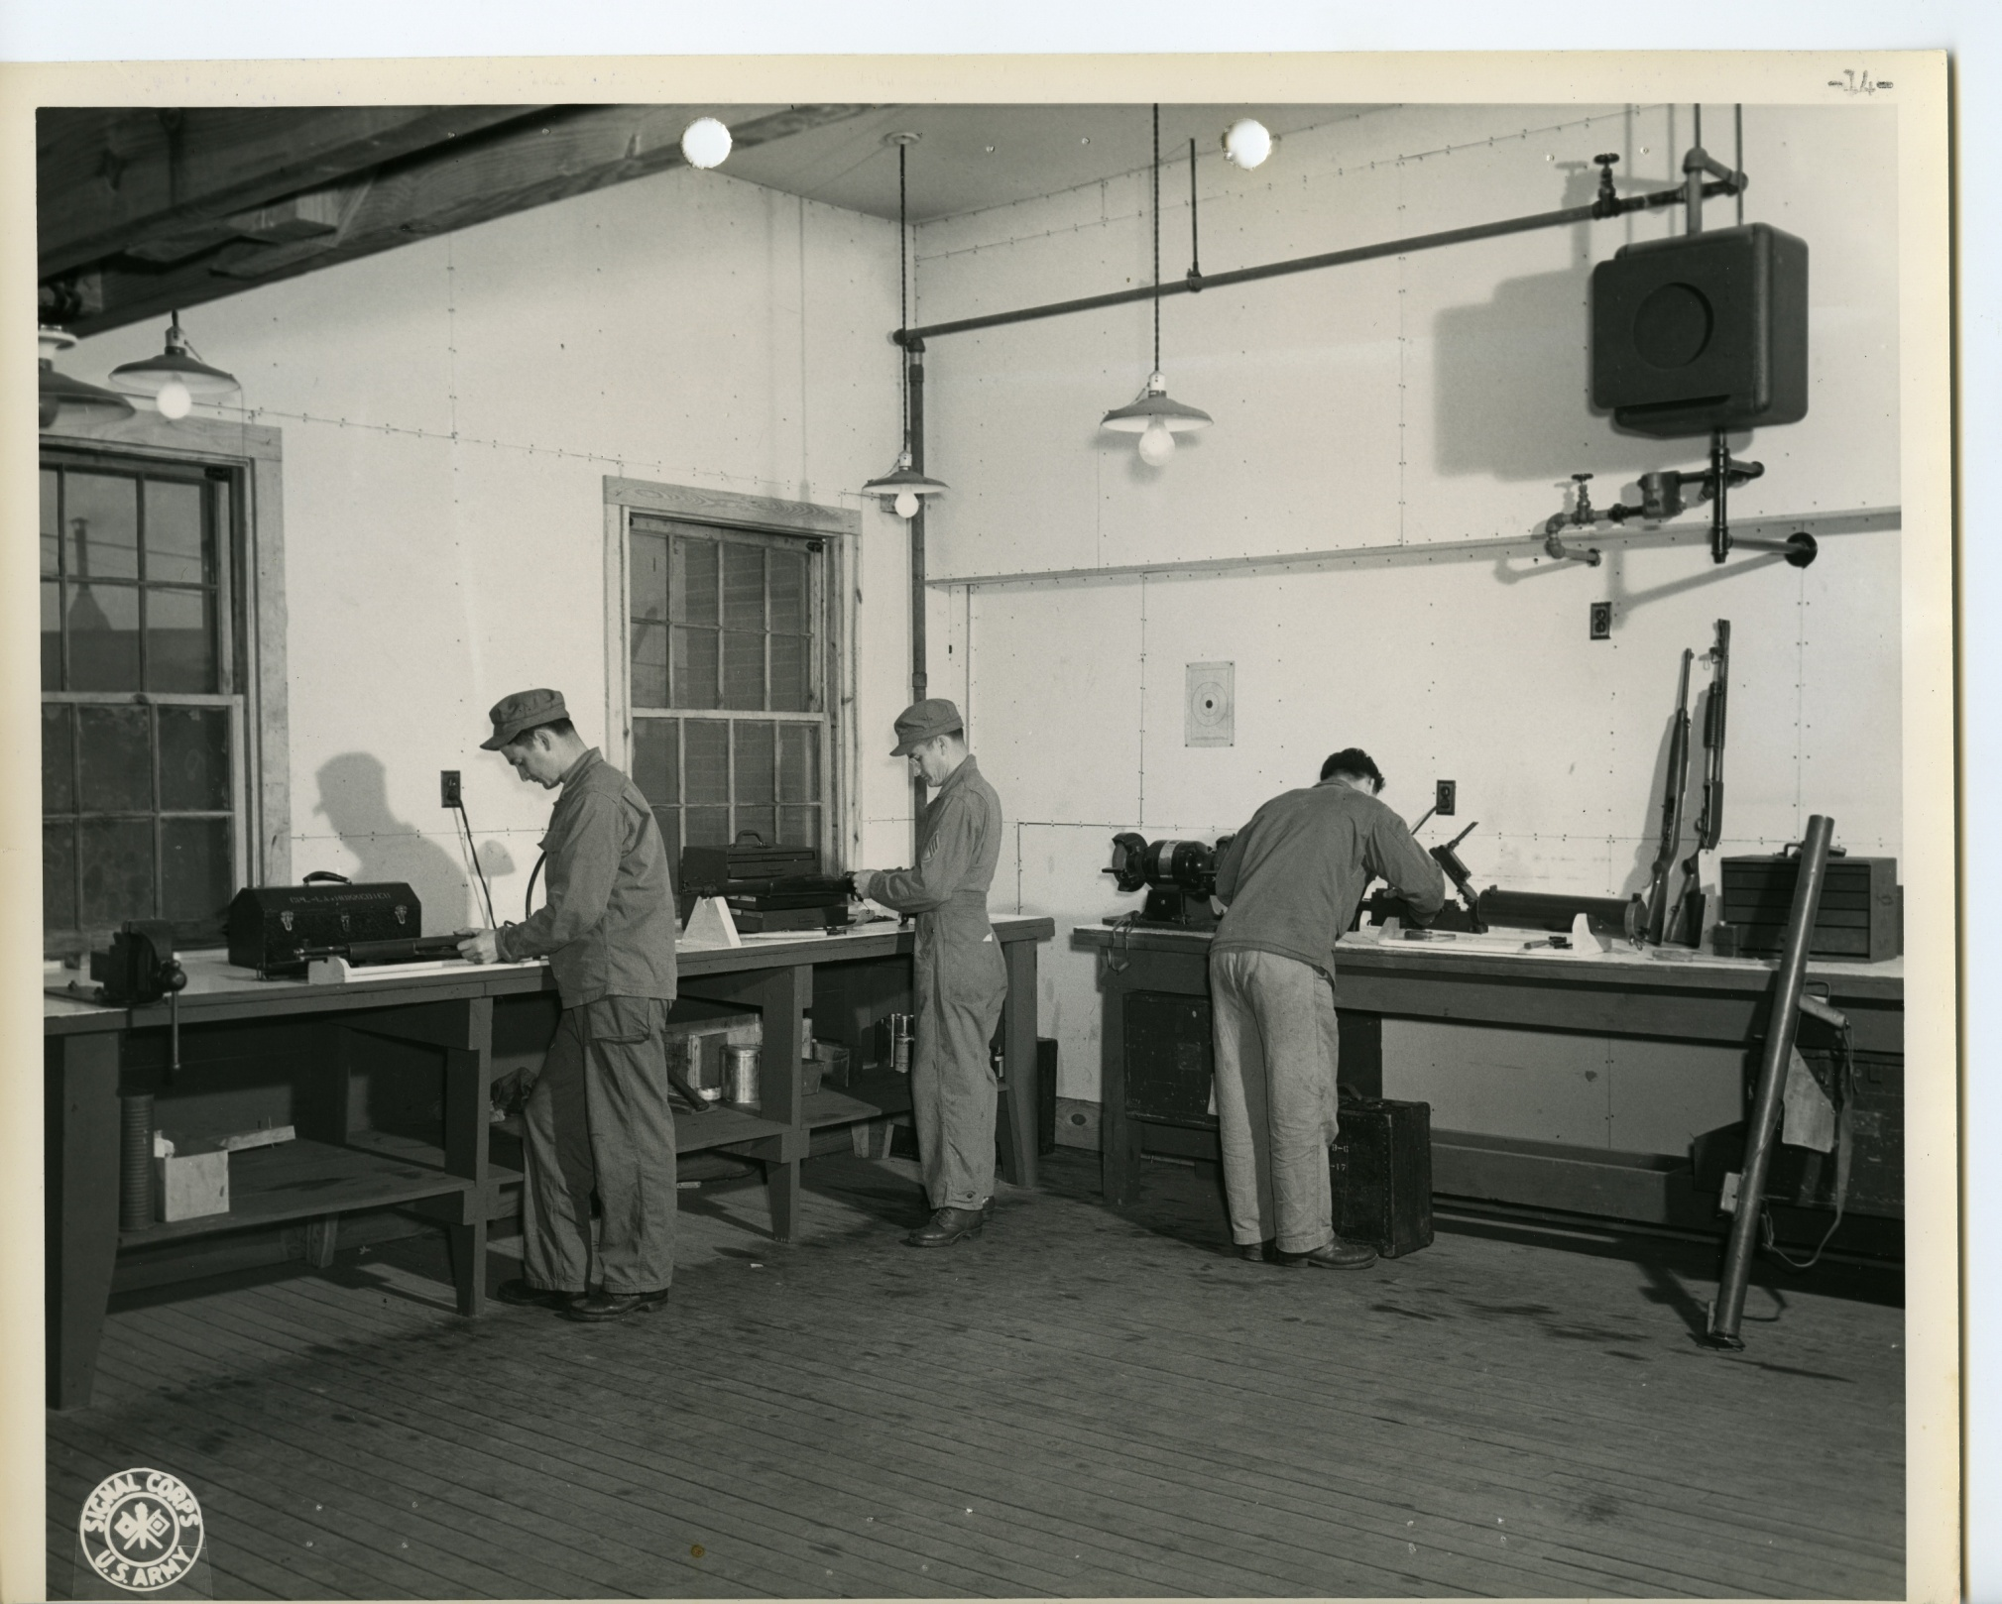
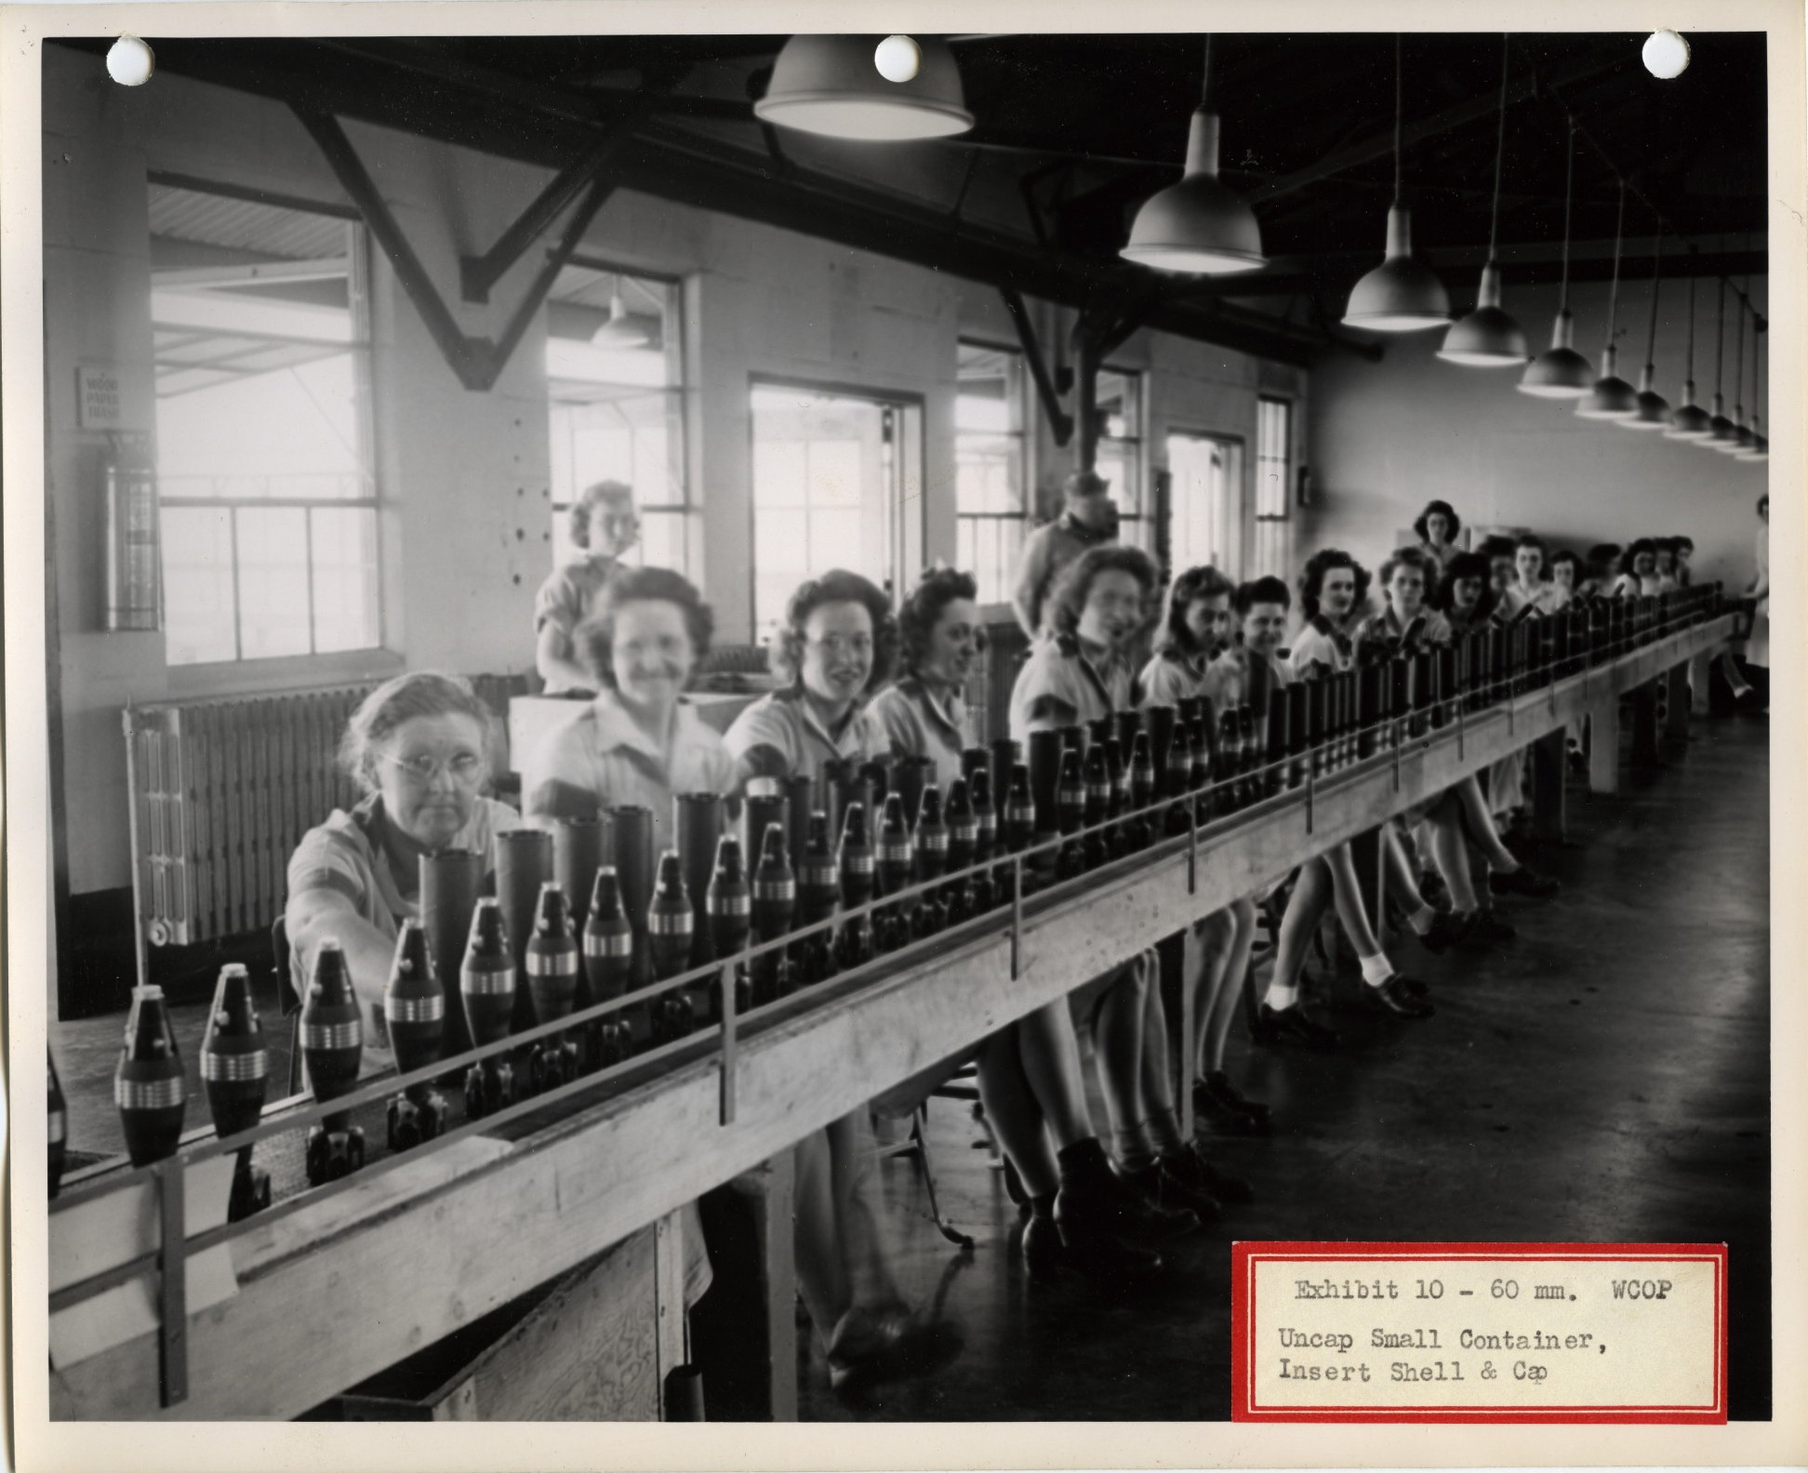
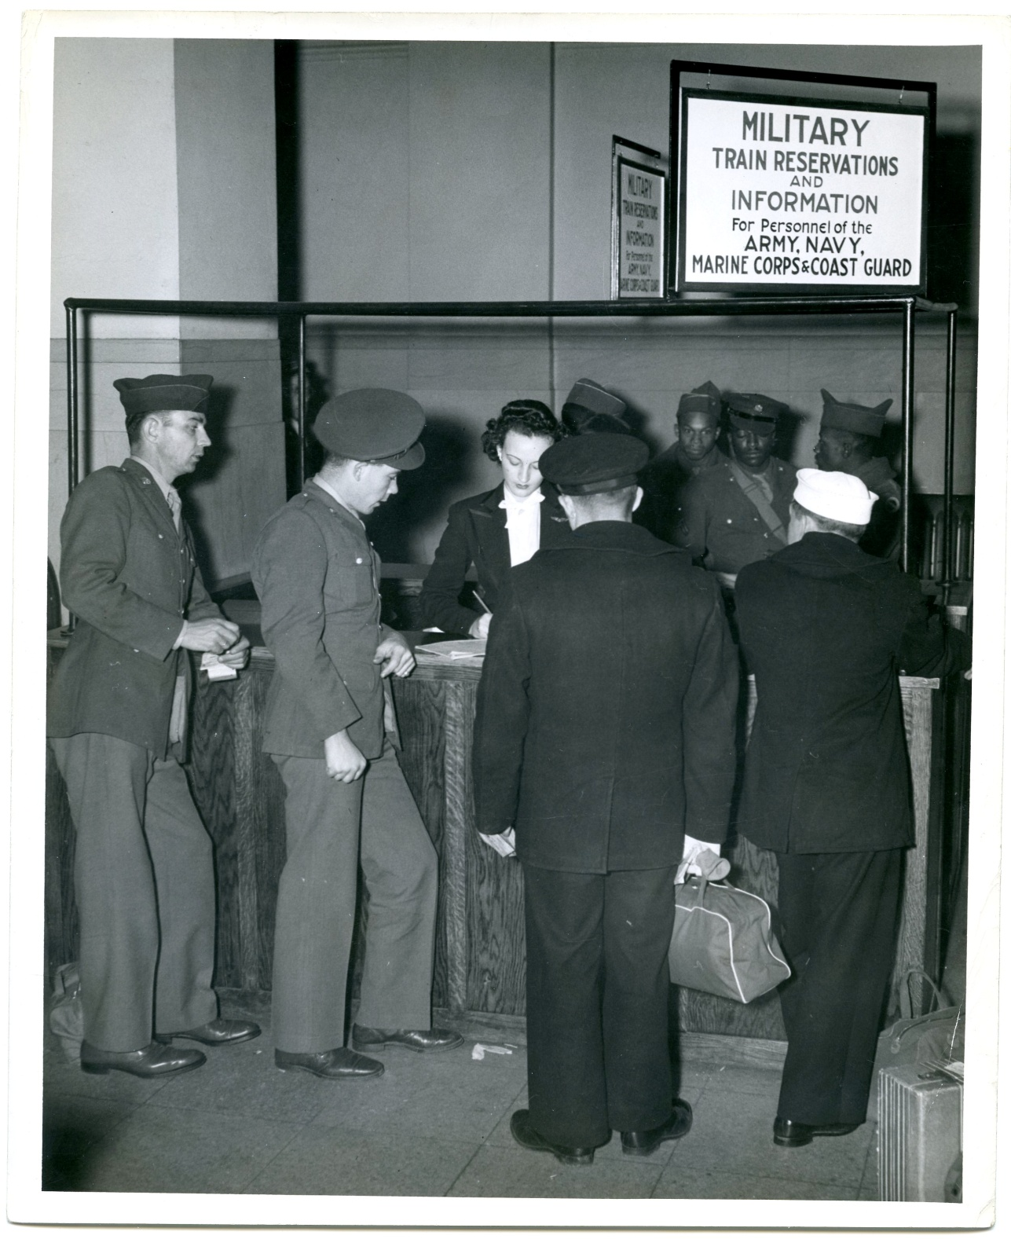
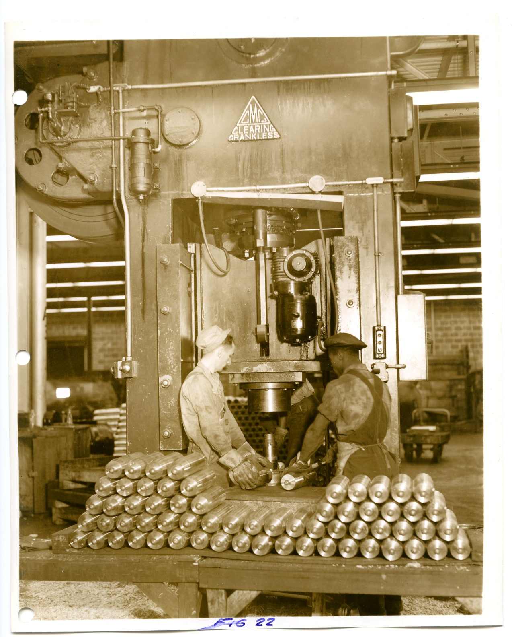
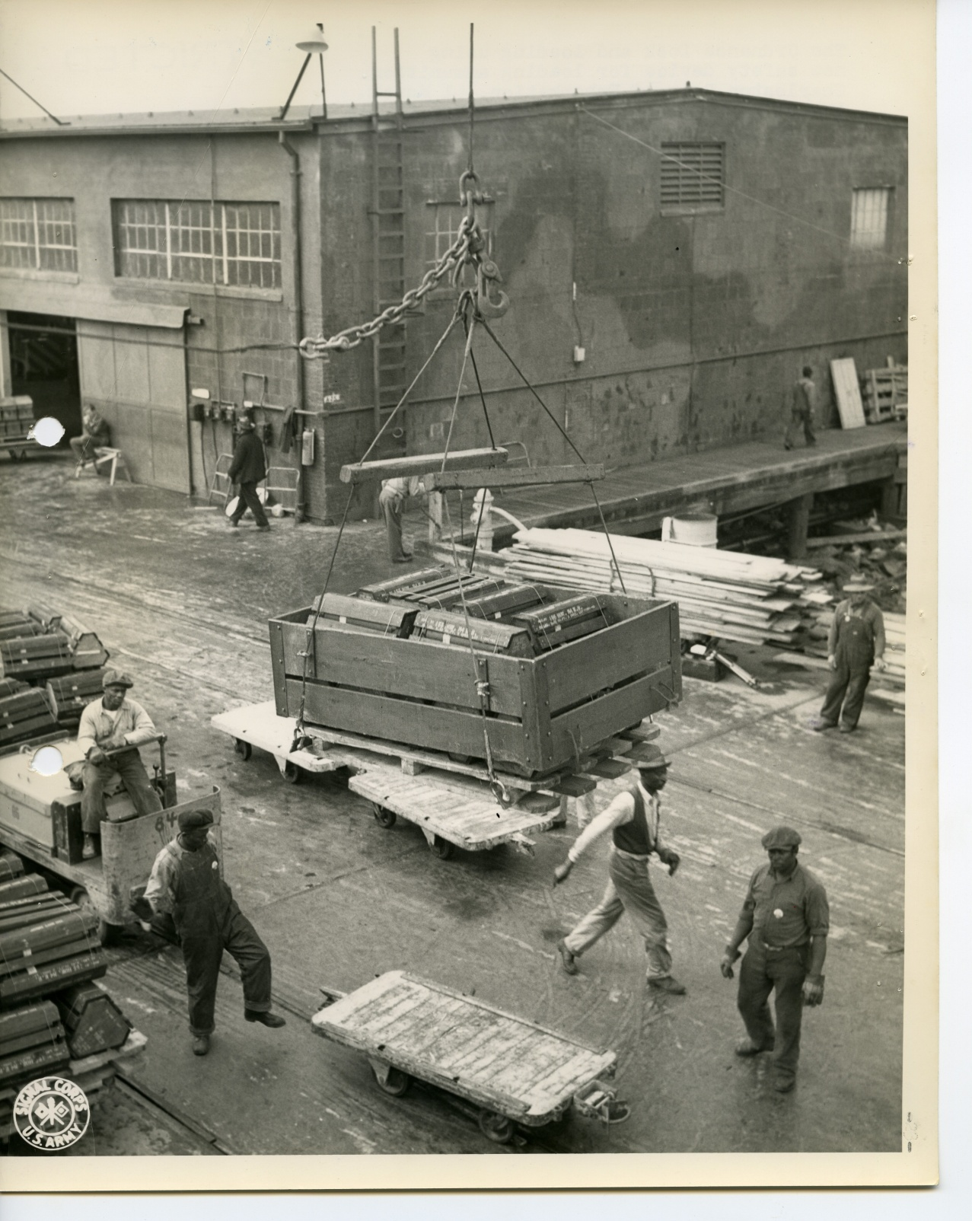

Slide 24
Transportation

Slide 25
Transportation in the Records
RG 30 – Bureau of Public Roads
Defense Highway Projects, construction, maps
RG 77 – Chief of Engineers
Airport construction
RG 219 – Office of Defense Transportation
Railroad administration and transport, maps
RG 237 – Federal Aviation Administration (Civil Aeronautics Administration)
Reorganization of federal aviation oversight
RG 336 – Office of Chief of Transportation
U.S. Army transportation and logistics

Slide 26
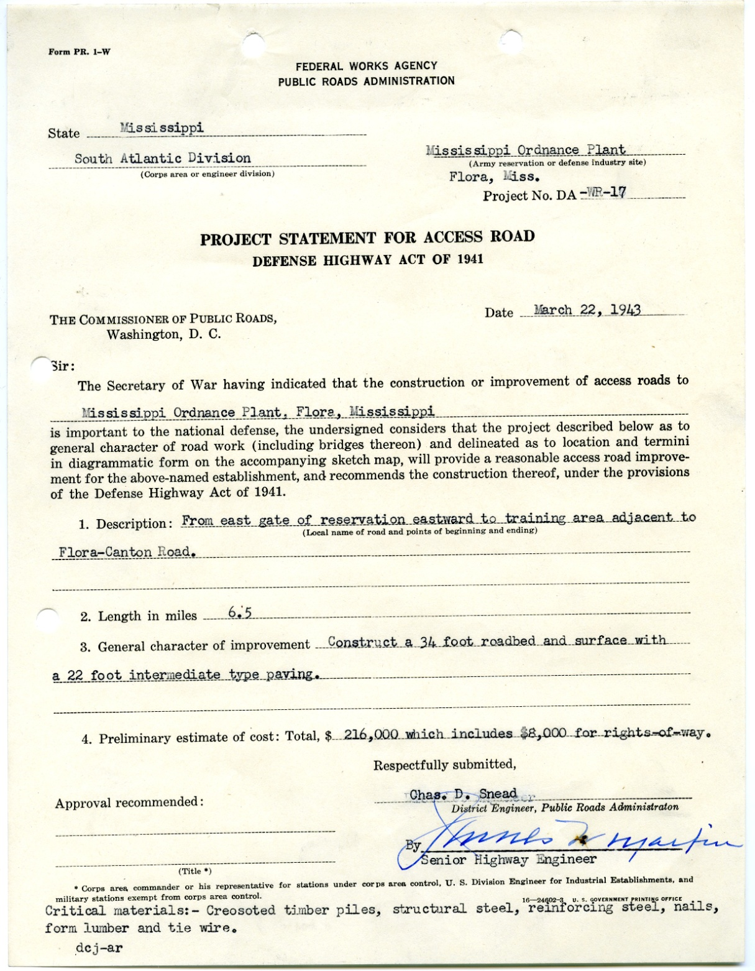
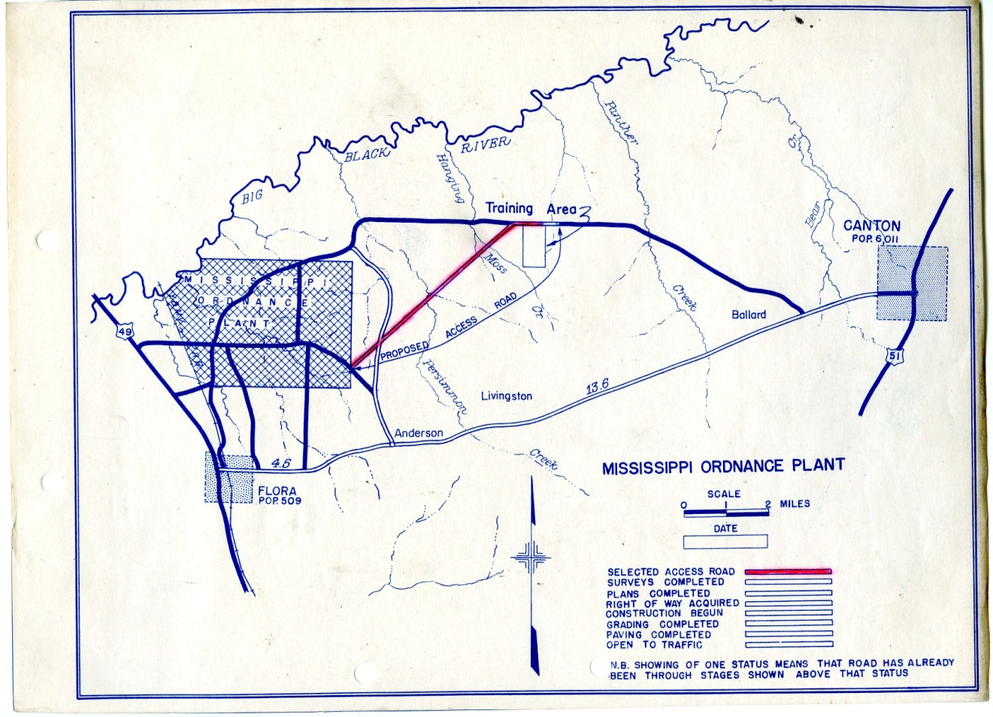
Infrastructure Projects
RG 30
Road Expansion at MS Ordnance Plant, 1943
Defense Highway Project Files, 1940-1950
Folder database

Slide 27
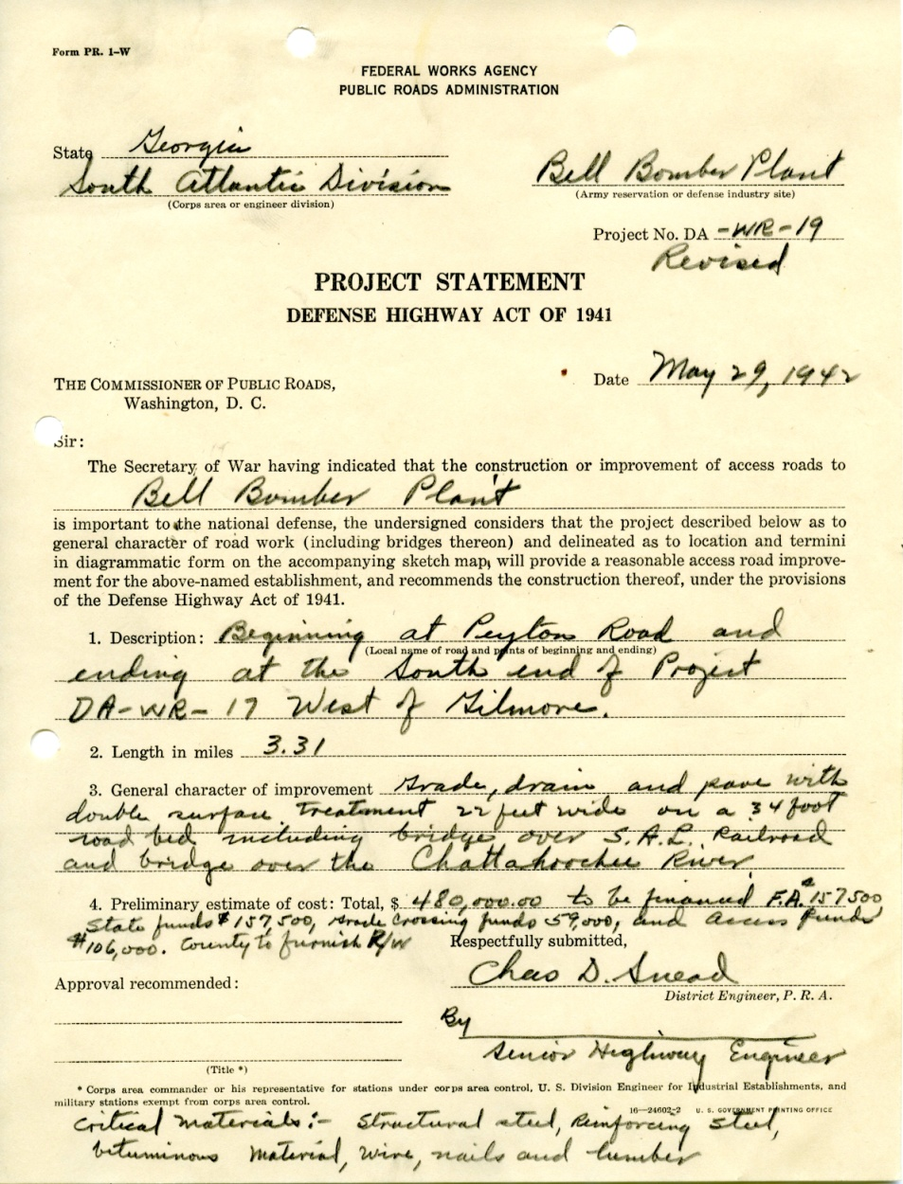
Infrastructure Projects 2
RG 30
Road Expansion at Bell Bomber Plant, 1943
Defense Highway Project Files, 1940-1950
Folder database

Slide 29
Traffic? In Atlanta?
RG 211
Atlanta Traffic Study, June 1942
Central Correspondence Files, 1942-1945
Folder List

Slide 30
Homeland defense

Slide 31
Defense Documentation
RG 181 – Naval Districts and Shore Establishments
U-boat attacks, intelligence files
RG 336 – Chief of Transportation
Training operations
RG 77 – Chief of Engineers
Naval training areas

Slide 32
Das Boot!
RG 181 6th Naval District
German U-Boat report, July 1942
Subject Files, 1941-1945
Folder List

Slide 33
Paranoia!
RG 181 7th Naval District
Report on Subversive Groups, December 1942
Formerly Classified General Correspondence, 1942-1945
Item Level Database

Slide 34
When in doubt… Investigate
RG 181 6th & 7th Naval Districts Intelligence Office
Security Investigations, 1942-1943
Formerly Classified General Correspondence, 1942-1945
Item Level Database

Slide 35
Labor and industry

Slide 36
Records of Labor and Industry
RG 142 – Tennessee Valley Authority
Construction, contracting, chemical production, propaganda materials
RG 156 – Chief of Ordnance
Weapons and ammo production, photos, newsletters, contracting
RG 188 – Office of Price Administration
Price panels, price regulation
RG 211 – War Manpower Commission
Working women, equal employment, job recruitment, certificates of availability, labor market reports

Slide 37
Before and After
May 15, 1941
January 1, 1942
June 1, 1941
January 27, 1942
RG 156
Alabama Ordnance Works Construction, 1941-1942
Assorted Records, 1941-1946
Finding Aid

Slide 38
Whiskey, Beer, and Chickens
RG 188
Chatham County Price Panel, July 1945
Price Records, Field Offices, Region 4, 1942-1946

Slide 39
Job Control
RG 211
Request for Job Transfer, 1944
Certificates of Availability, 1943-1945
Item Level Database

Slide 40
Woman Power!
RG 211
Womanpower campaign booklet, January 1943
Central Files and Monthly MOPAC Reports, 1942-1943
Folder List

Slide 41
Who knew that women were so talented?!
RG 211
RCA supervisor booklet, 1943
Central Files and Monthly MOPAC Reports, 1942-1943
Folder List

Slide 42
Man Rationing?
RG 156
Salute Newsletter, May 1943
Assorted Arsenal Files, 1942-1955
Finding Aid

Slide 44
Hiring Archivists!
RG 156
Establishment of Ordnance Historical Section, September 1942
Assorted Arsenal Files, 1942-1955
Finding Aid available

Slide 45
Questions
Cutting the Red Tape!
The National Archives at Atlanta Staff, 2013
Letter to the Augusta (GA) Arsenal, October 3, 1895; Letters and Invoices Received, 1867-1903; Records of the Chief of Ordnance, Record Group 156.

